Slide 1


Exposure CS 2021
for CS1
Chapter 8 Section 7-9 Slides
Creating Custom Colors and Repetition
with Random Numbers and Graphics
PowerPoint Presentation
created by:
Mr. John L. M. Schram
and Mr. Leon Schram
Authors of Exposure
Computer Science

Slide 2
Section 8.7
Creating
Custom Colors

Slide 3
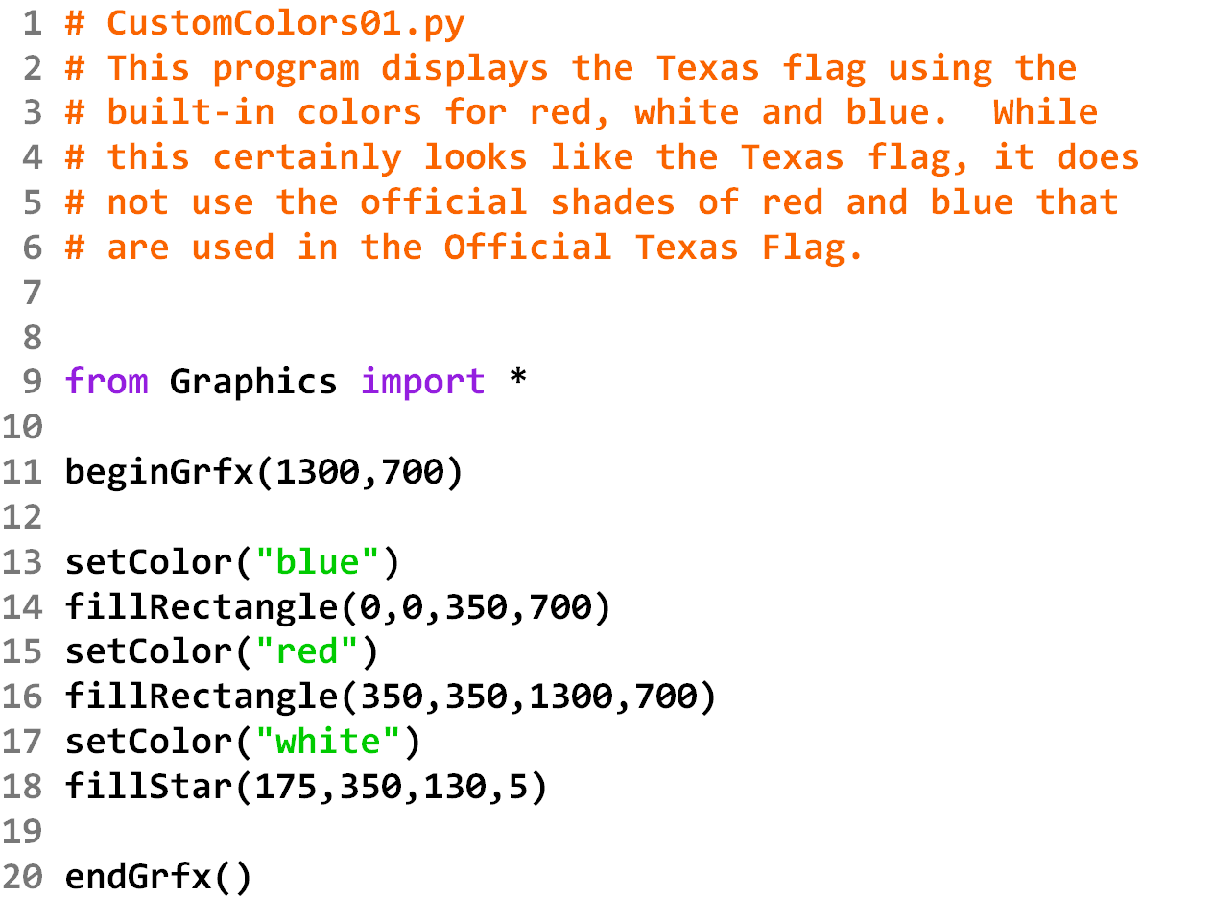

Slide 4
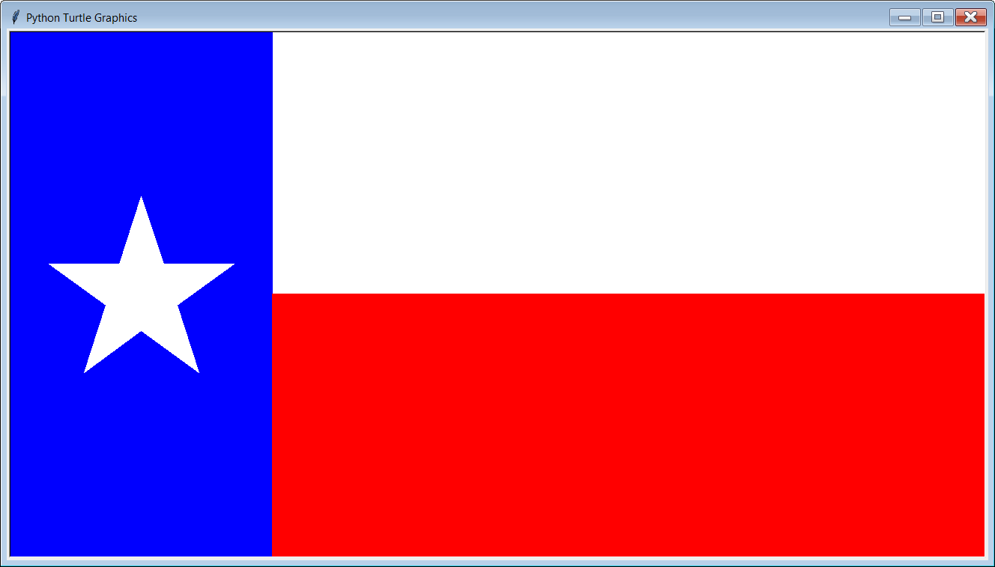

Slide 5
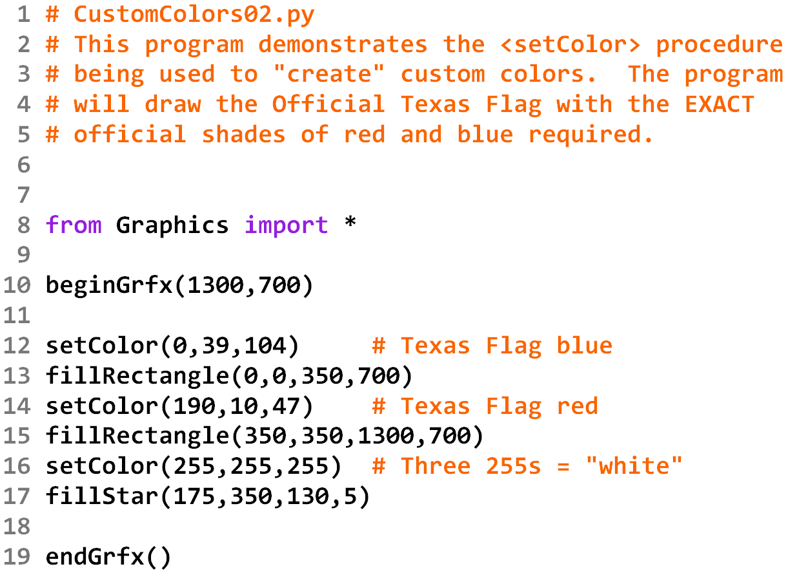

Slide 6


Slide 7
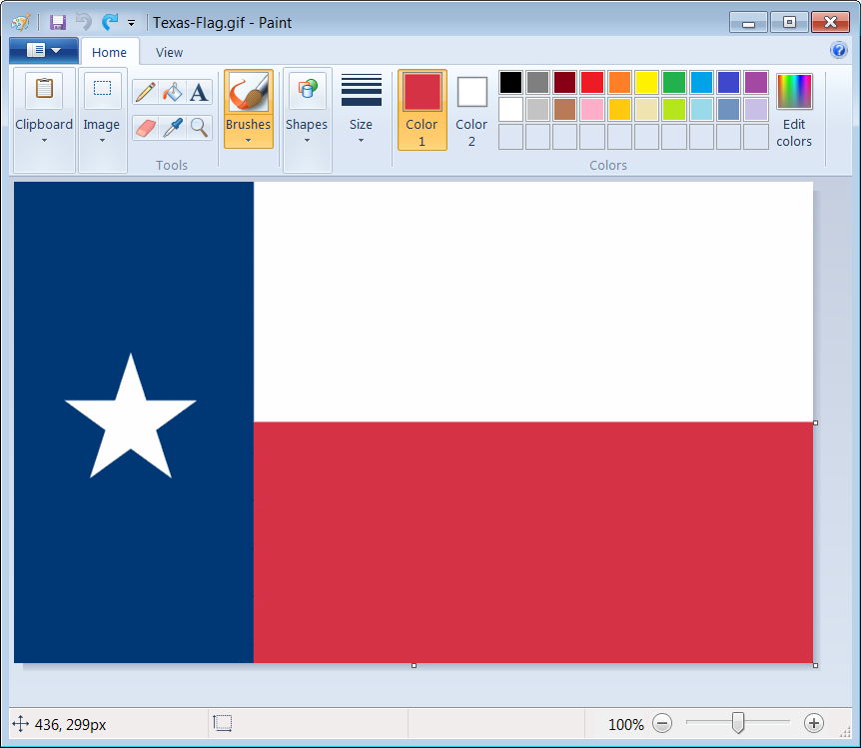
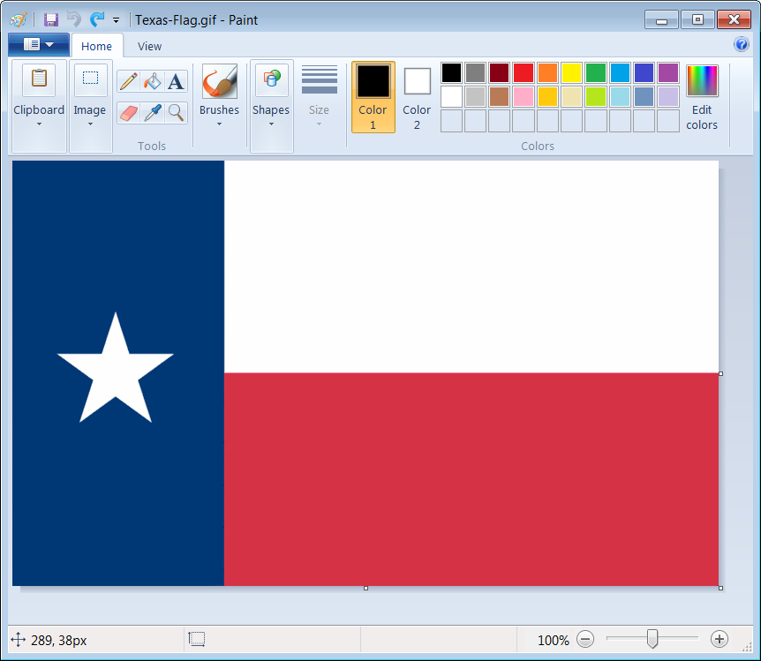
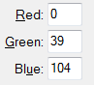
Where do you get the 3 color #s
I started by downloading an image of the Official Texas Flag.
I then loaded it in MS Paint.
Using the eye-dropper tool,
I then clicked on
the desired color.
I then clicked
[Edit Colors] and
made note of the red,
green & blue values.
By using the same 3 numbers in my program, I get the exact same color in
the output of my Python program:
setColor(0,39,104)

Slide 8
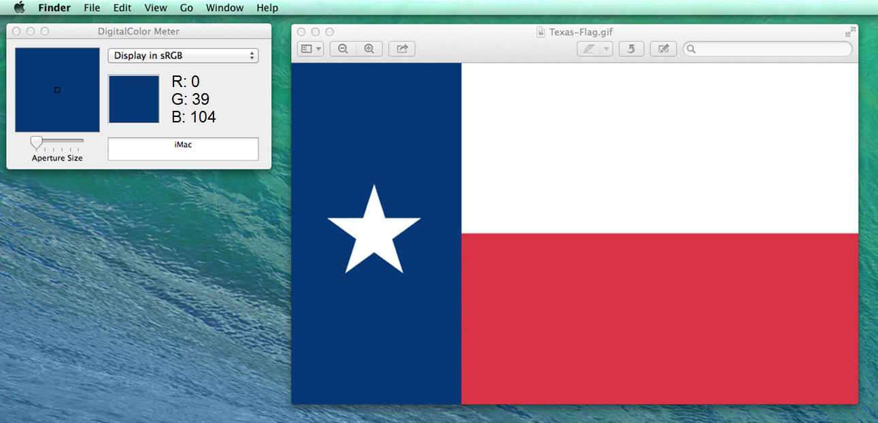
You can use DigitalColor Meter on a Mac
Double-click the image; which will open it up in a Preview window.
Open DigitalColor Meter. (You can do a search for it.)
Move your mouse pointer inside the preview window over the desired color.
The DigitalColor Meter will show you the red, green and blue values.
Make sure this says:
Display in sRGB

Slide 9
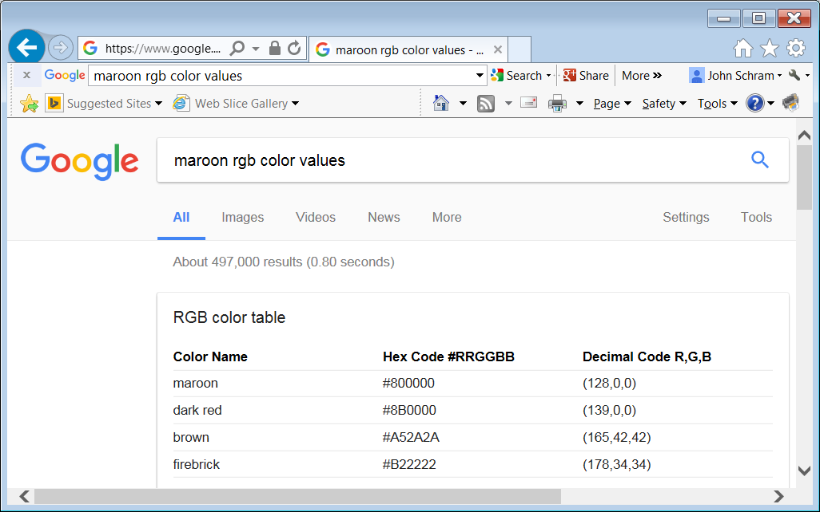
You can also just do a Google search for most RGB color values.

Slide 10
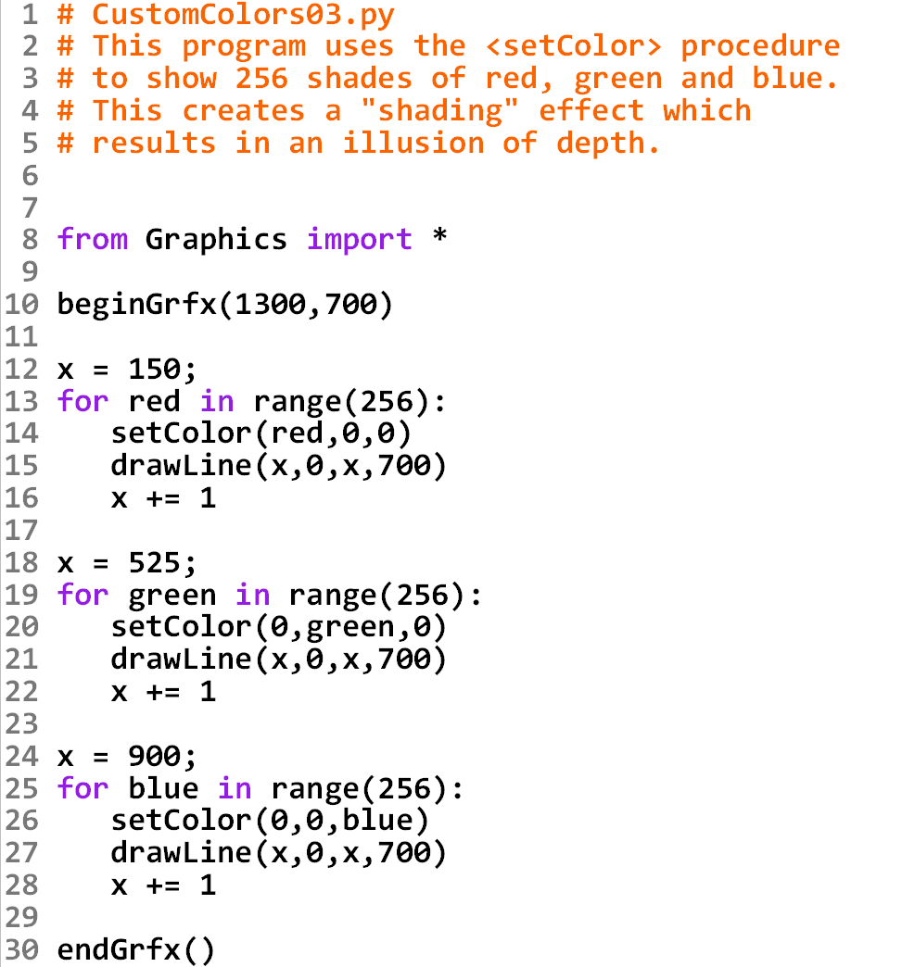
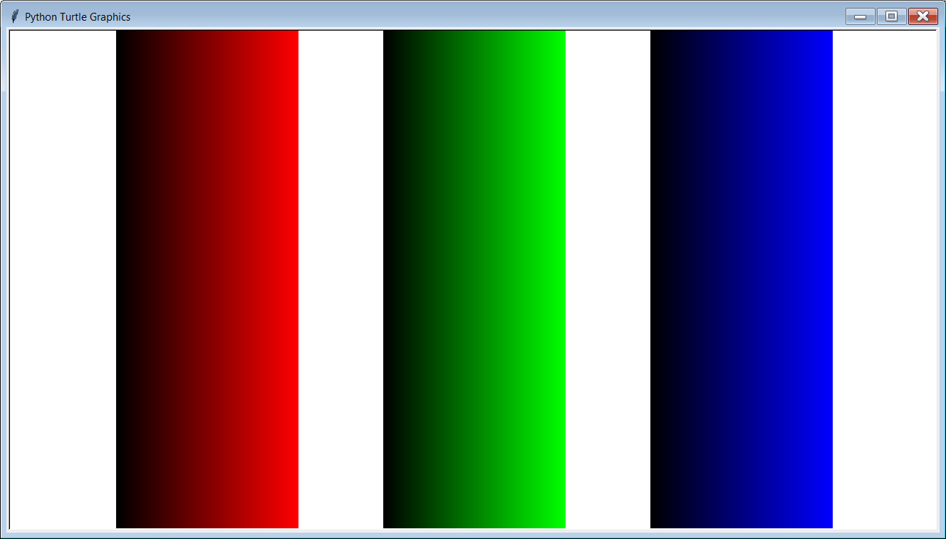

Slide 12
Section 8.8
Creating
Random
Numbers

Slide 13
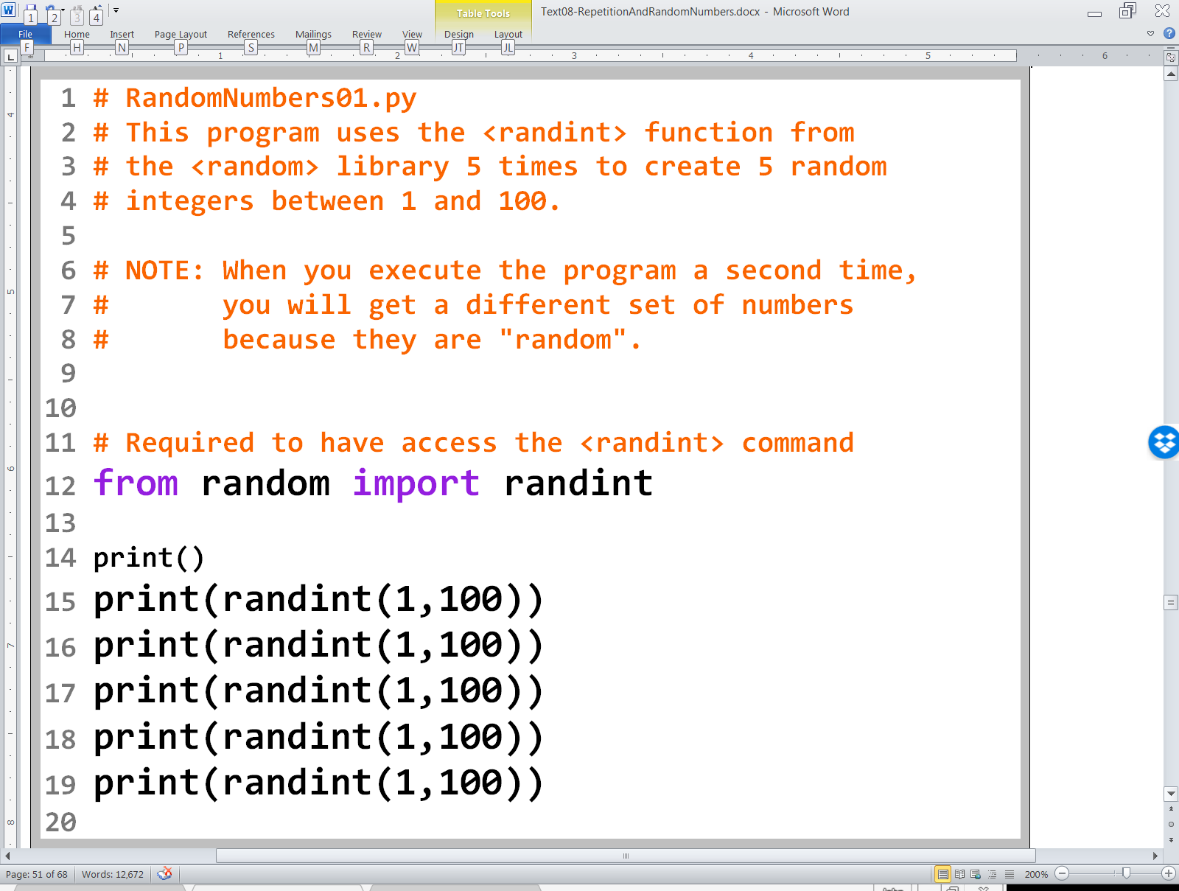

Slide 14
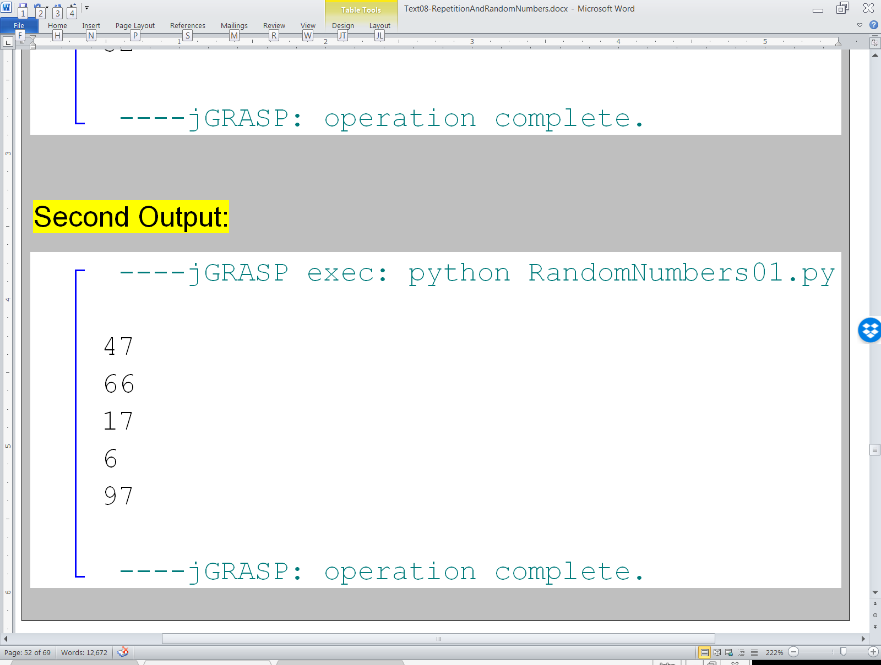
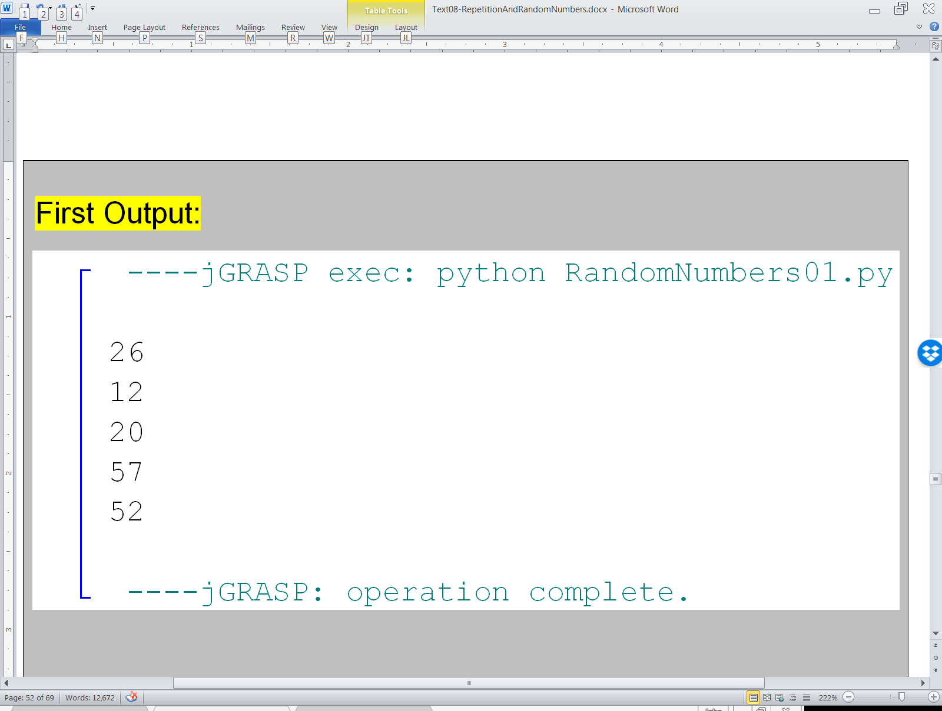
Since we are working with
RANDOM numbers,
your outputs
will be different than mine –
and also different from the
other students in the class.

Slide 15
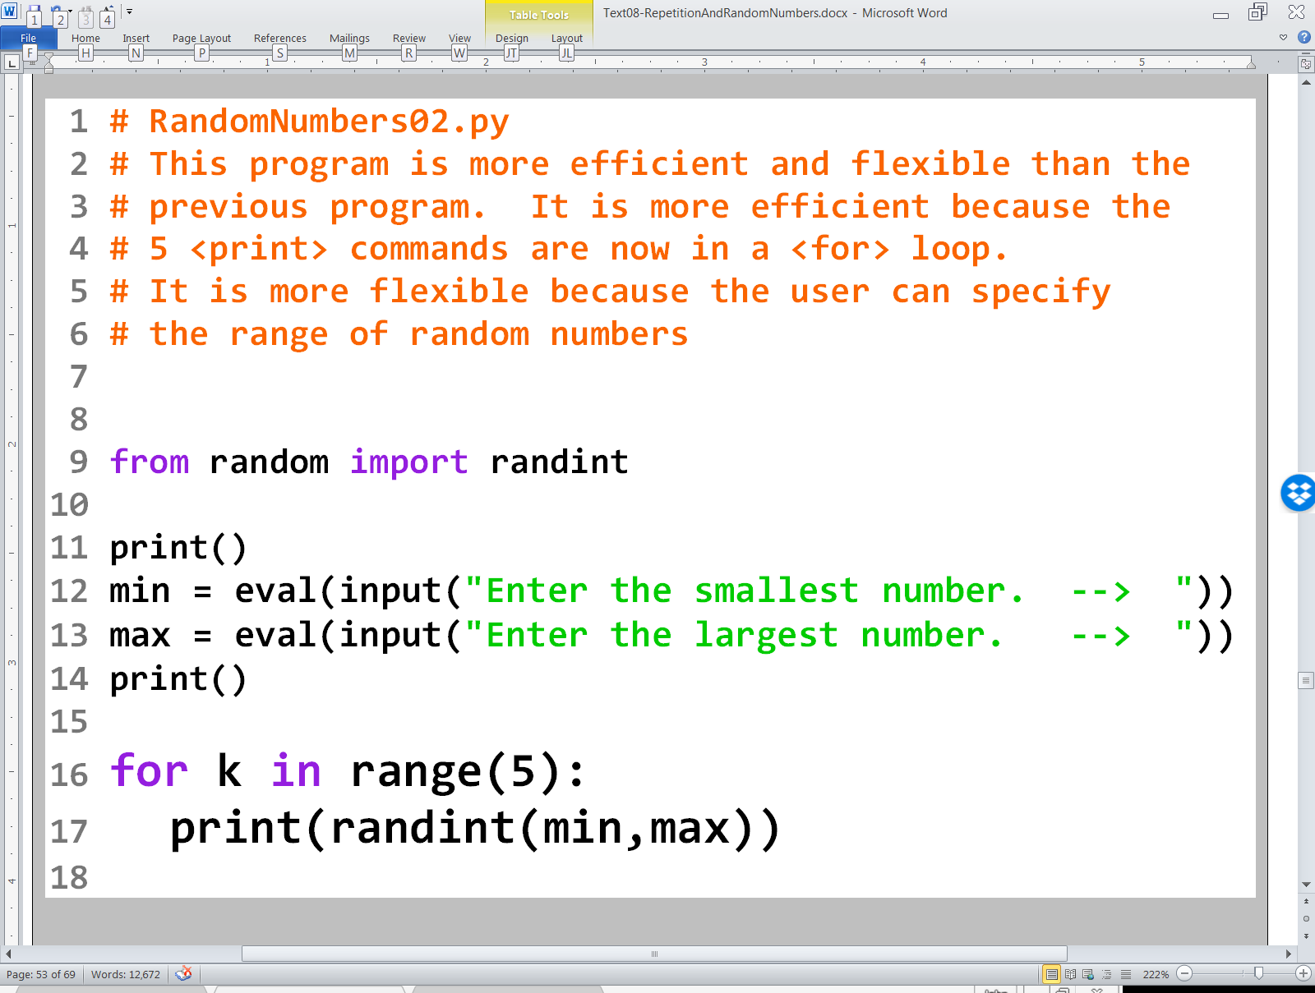

Slide 16
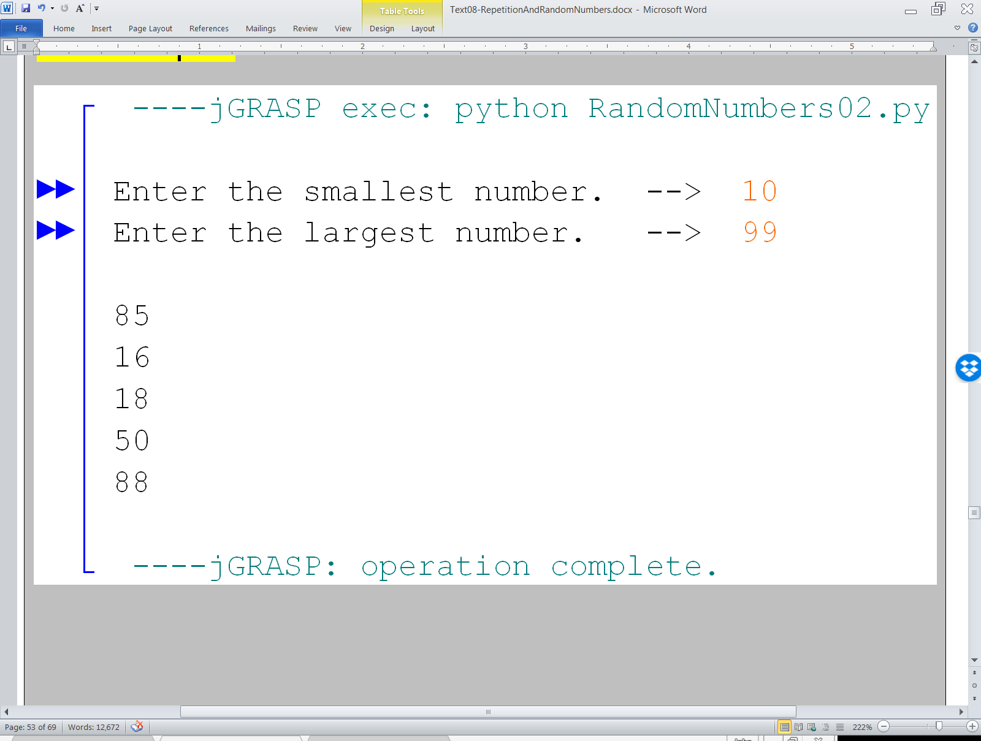
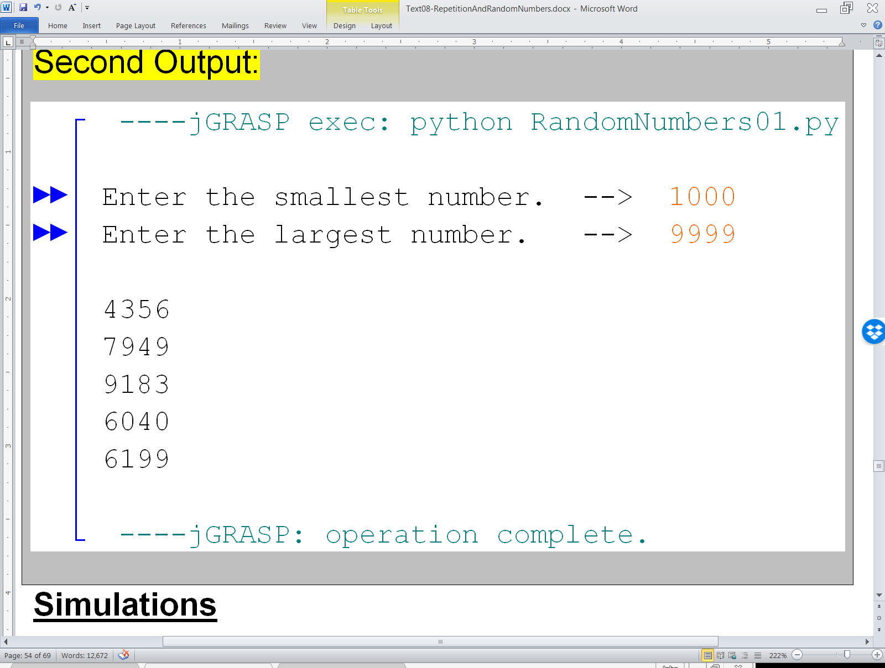

Slide 17
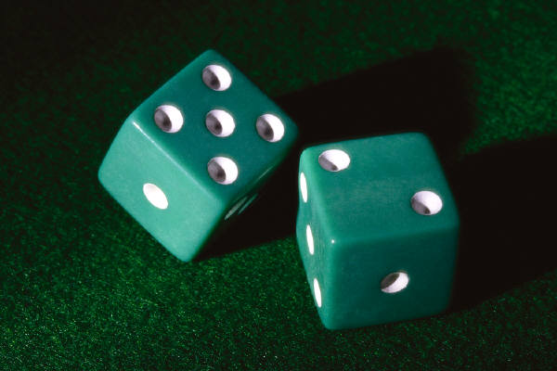

Simulations
Random numbers are used extensively in computer simulations.
The next 2 programs
deal with a simple
simulation of rolling
2 dice 1,000,000 times.
This same concept is also used
in video games, military software
statistics and cryptology.

Slide 18
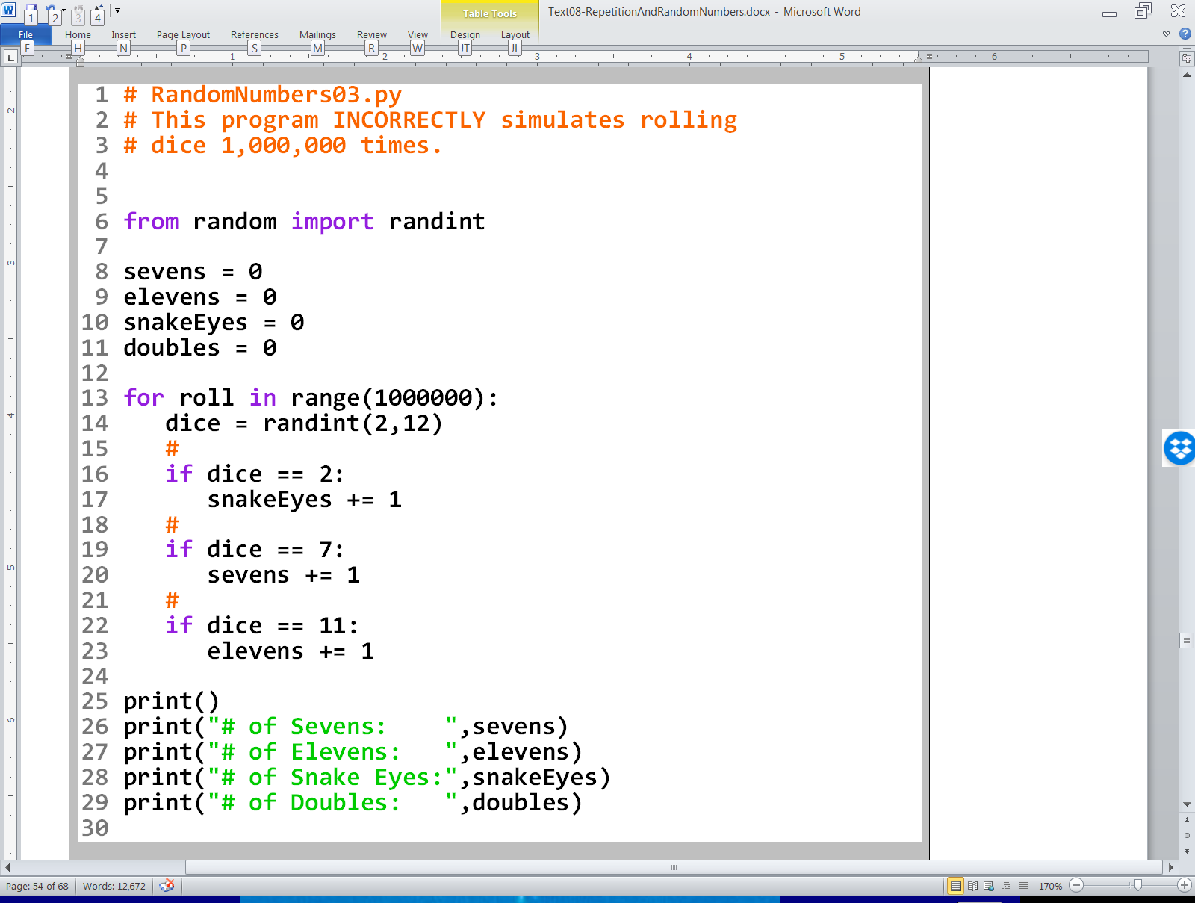

Slide 19
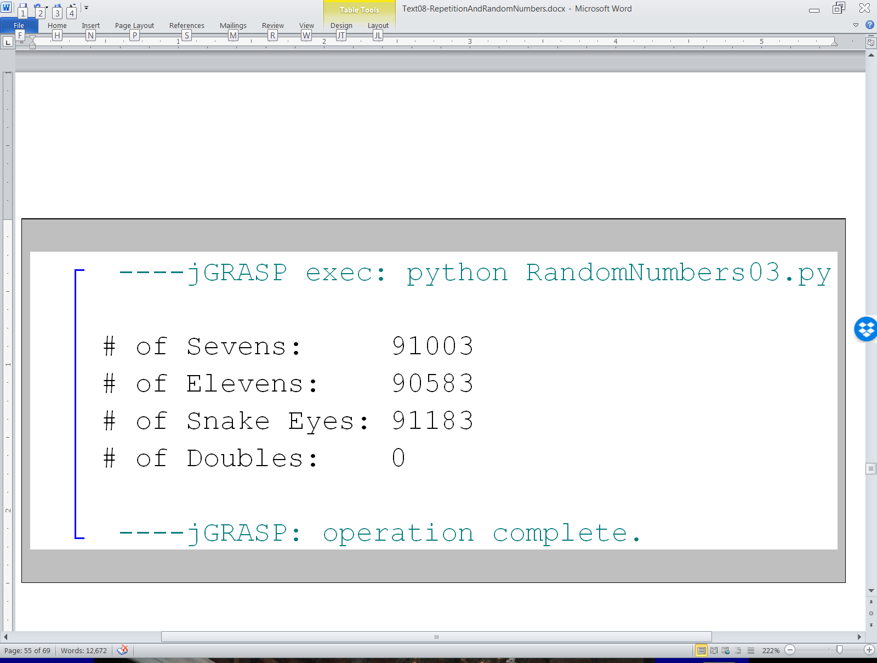

Slide 20



What else is wrong?
Aside from the double issue the simulation seems OK.
It may seem logical to think that the number of
2s, 7s, and 11s rolled would be about the same. However, this is not true. Look at the chart below:
Dice | 1 | 2 | 3 | 4 | 5 | 6
1 | 2 | 3 | 4 | 5 | 6 | 7
2 | 3 | 4 | 5 | 6 | 7 | 8
3 | 4 | 5 | 6 | 7 | 8 | 9
4 | 5 | 6 | 7 | 8 | 9 | 10
5 | 6 | 7 | 8 | 9 | 10 | 11
6 | 7 | 8 | 9 | 10 | 11 | 12

Slide 21
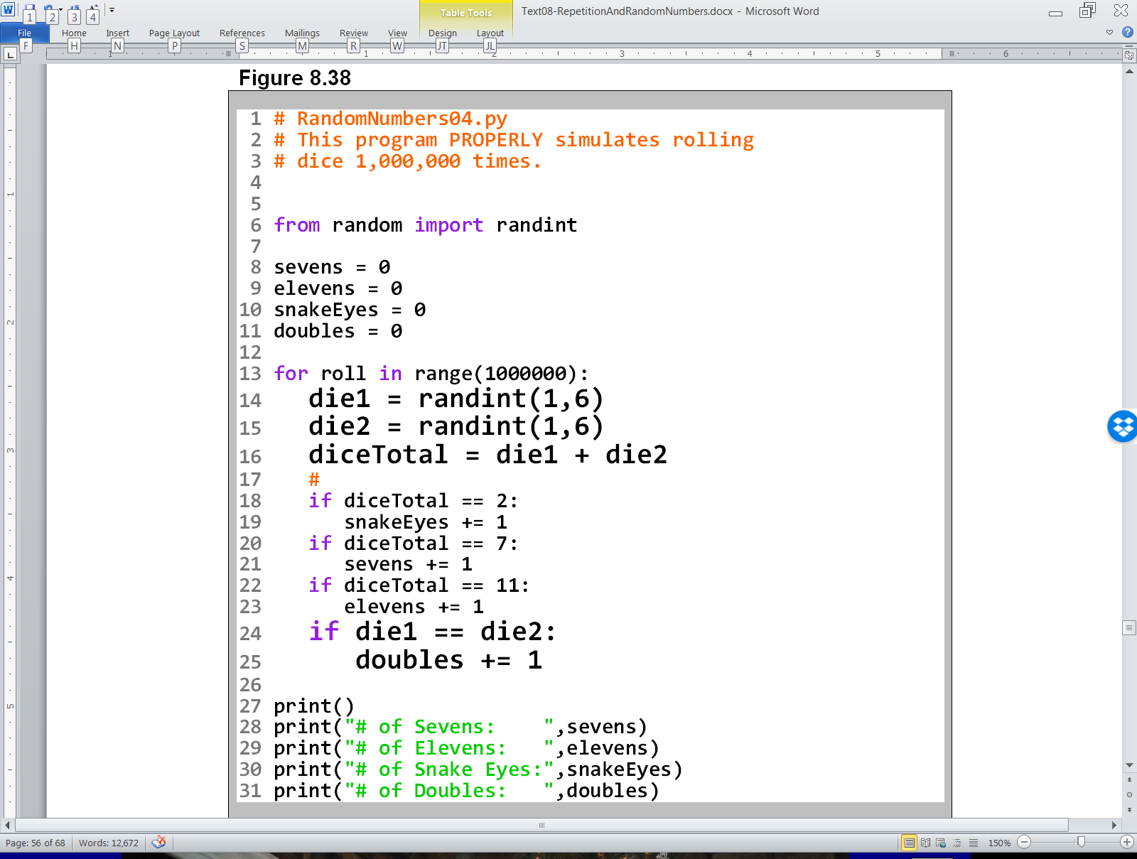

Slide 22
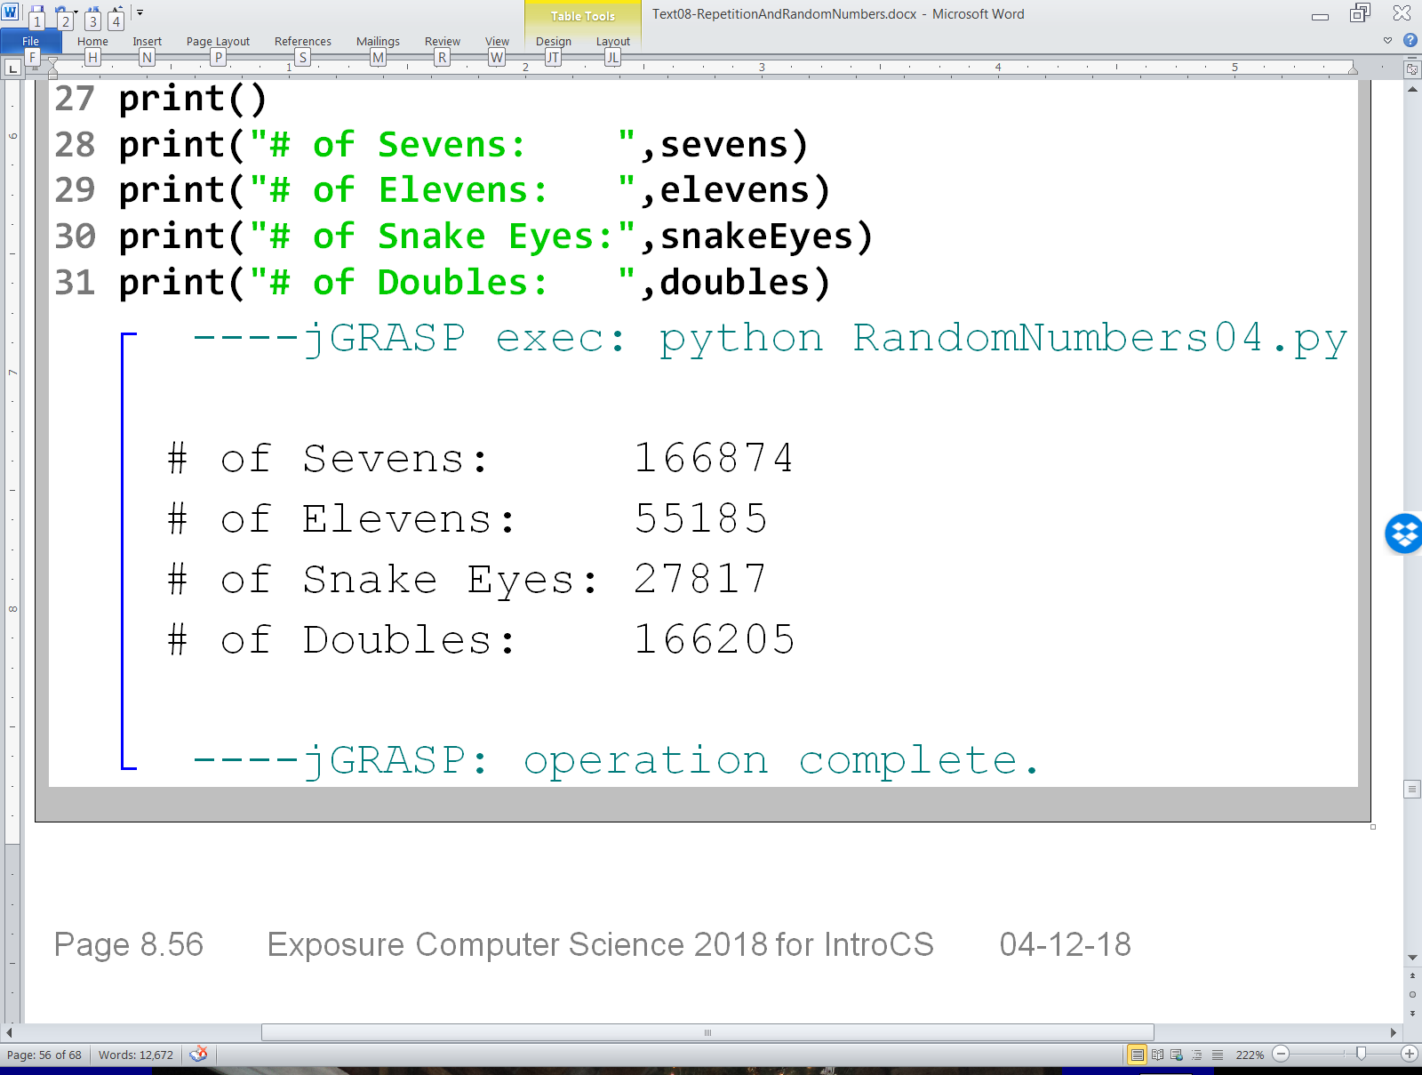

Slide 23
Section 8.9
Using Random #s
with Graphics

Slide 24
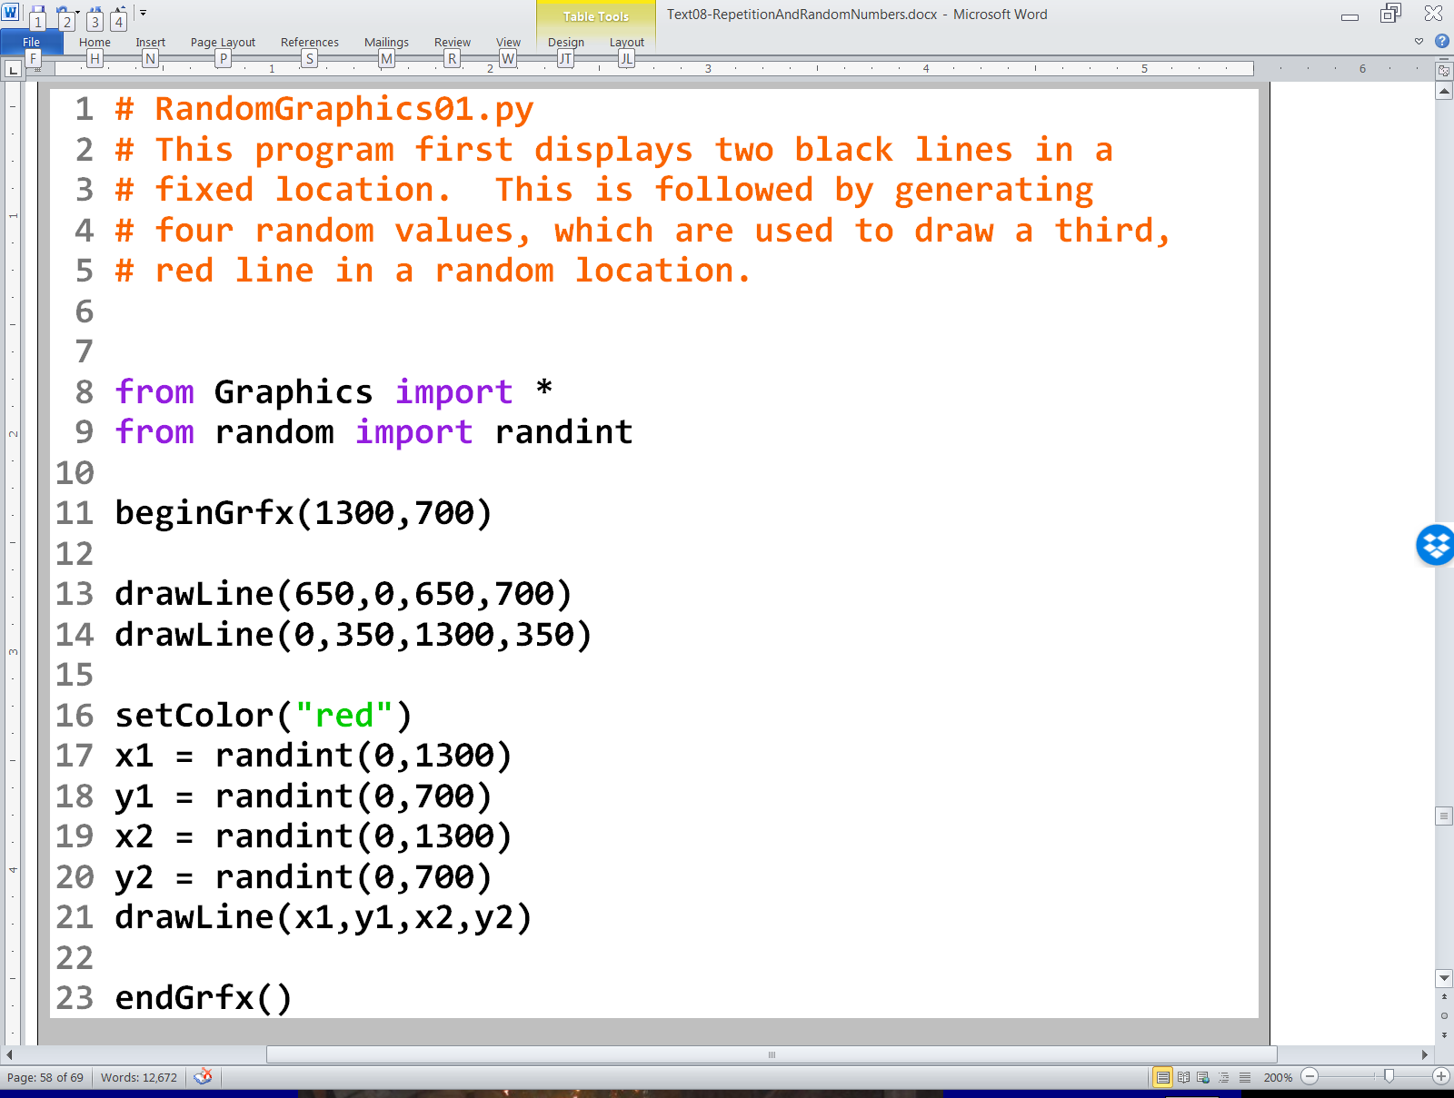

Slide 25
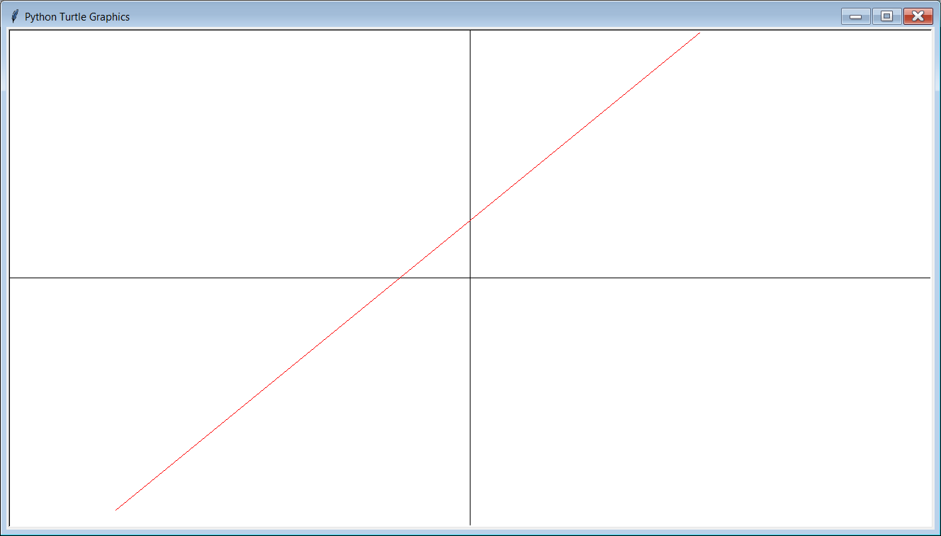
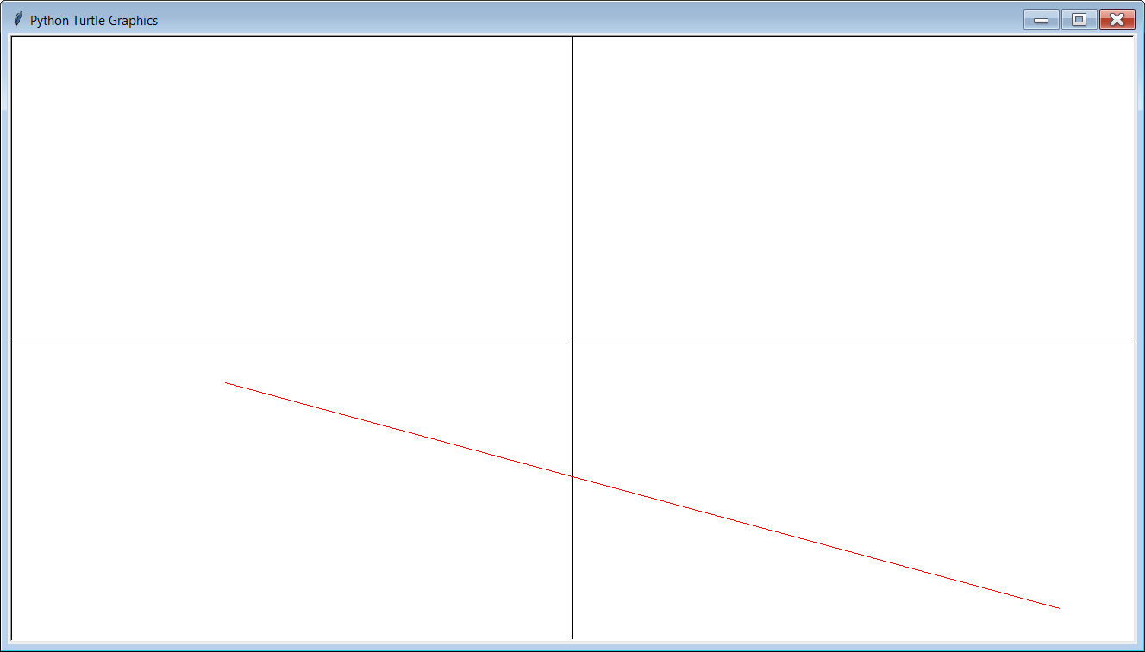
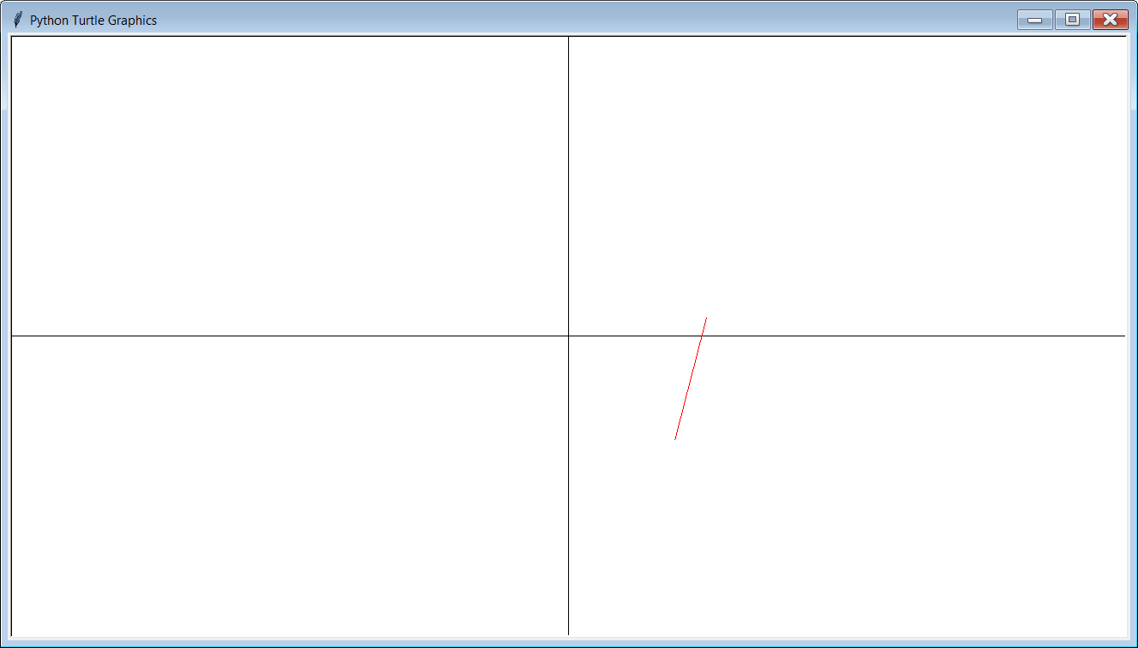

Slide 26
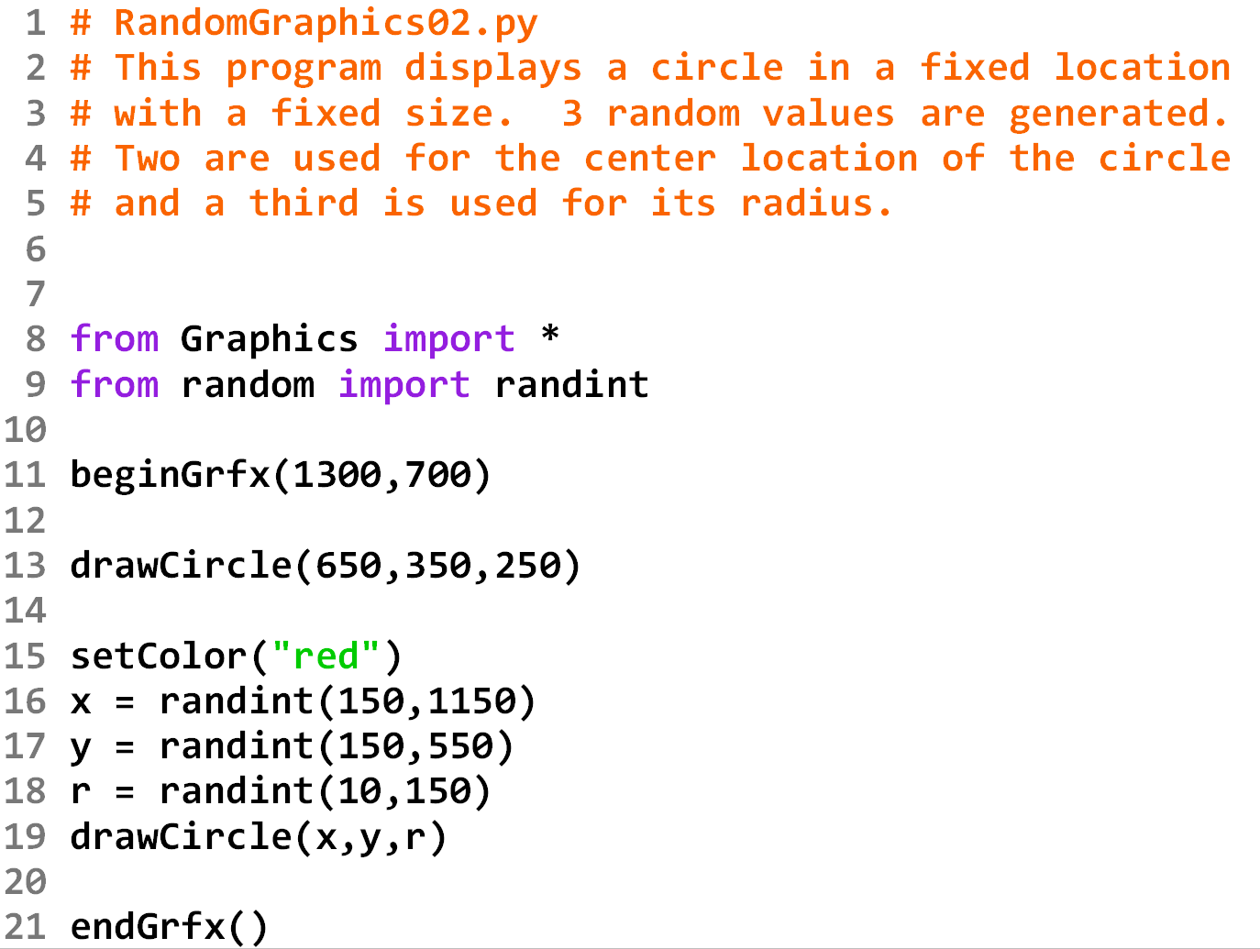

Slide 27
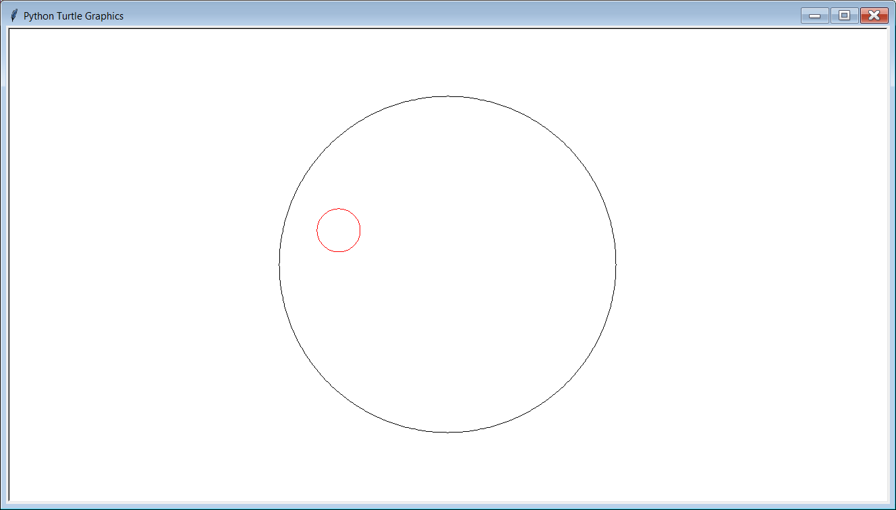
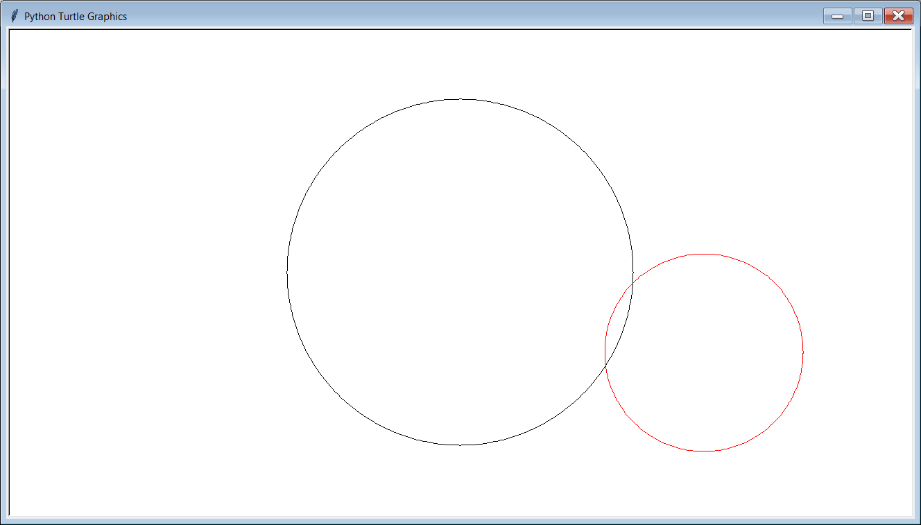
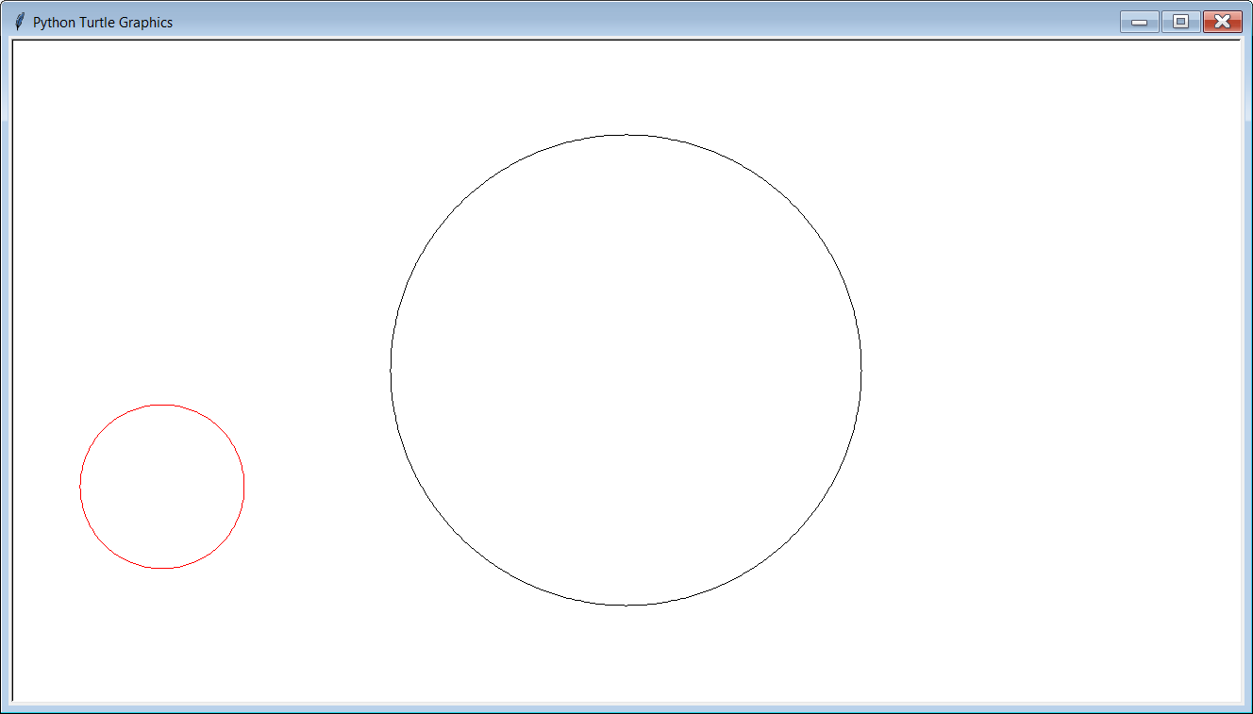

Slide 28
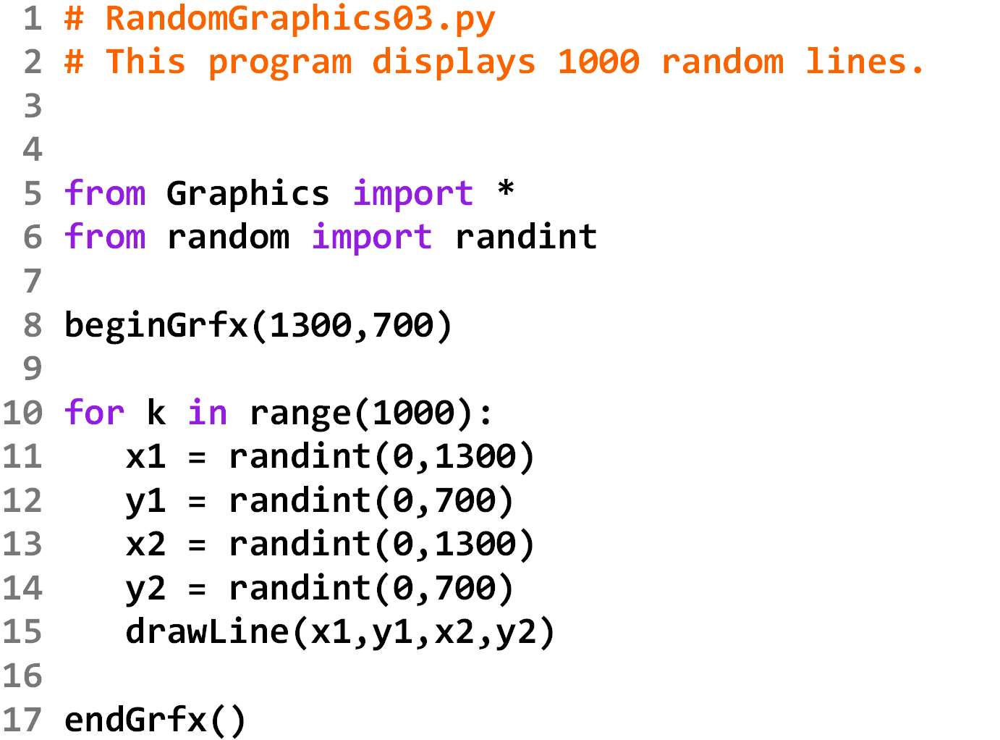

Slide 29
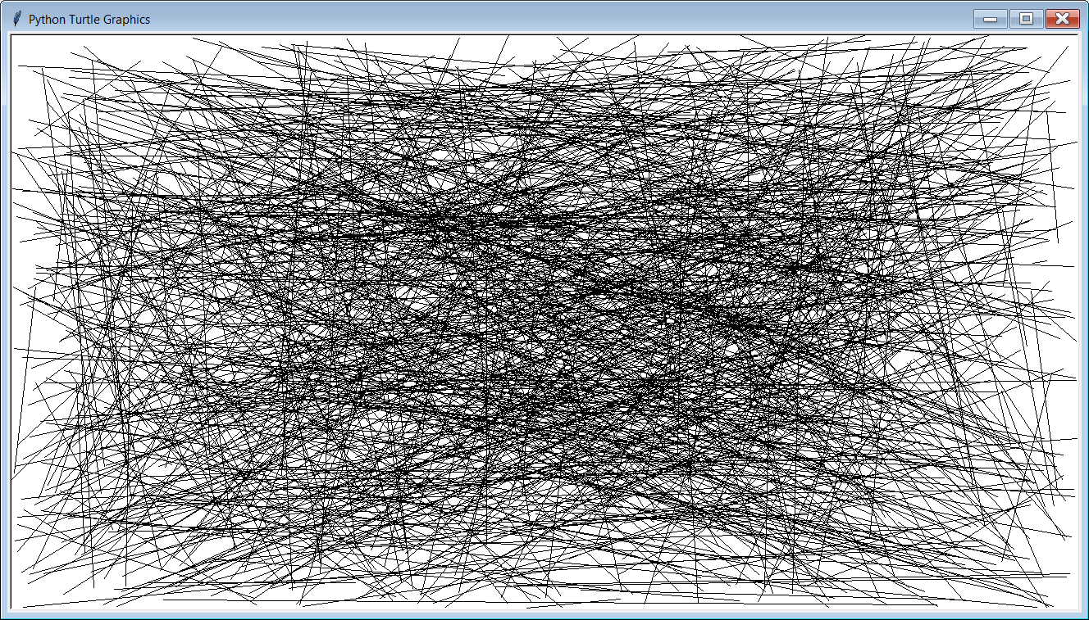

Slide 30

Changing Random Number Ranges to Affect the Graphics Program Output
The next several slides will still show program RandomGraphics03.py, but the output of the program is different. You need to figure out how to change the each program to make it produce the output shown.
NOTE:
This skill is essential
in doing Lab 8C!

Slide 31
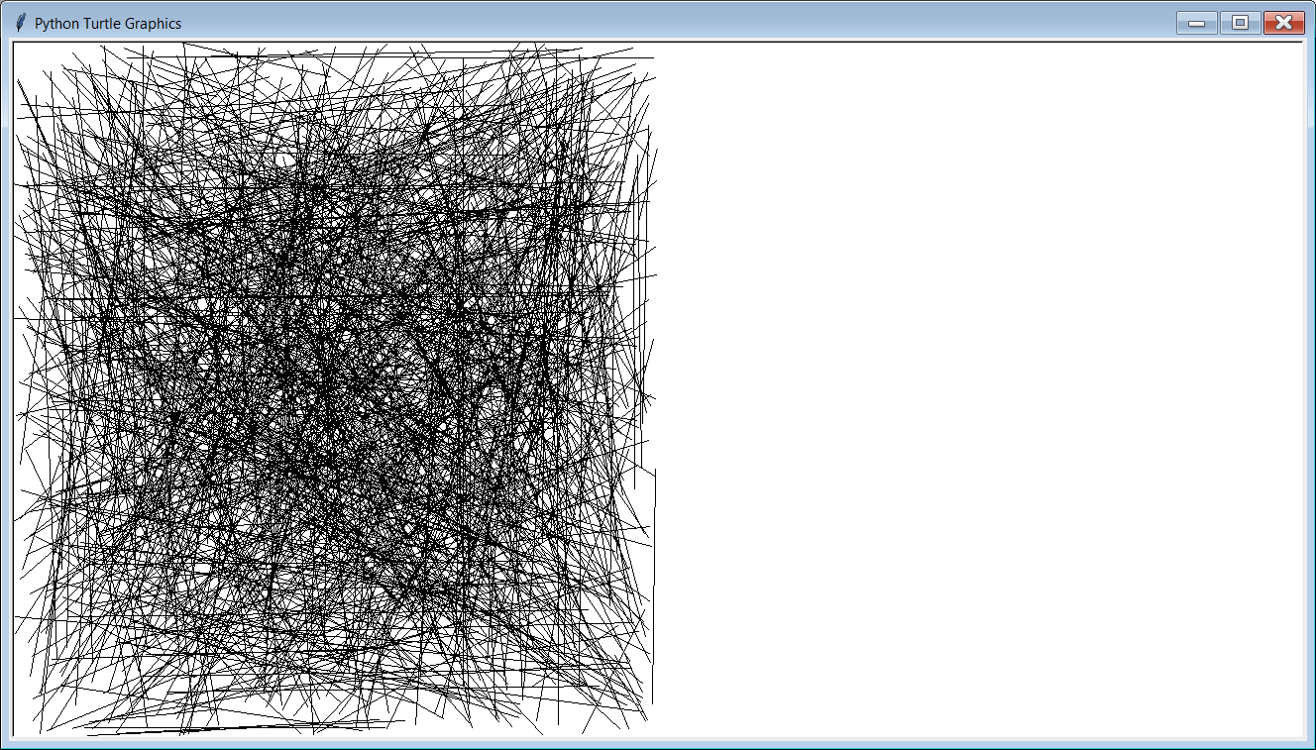
Make the random lines
only show up on the
left ½ of the screen.

Slide 32
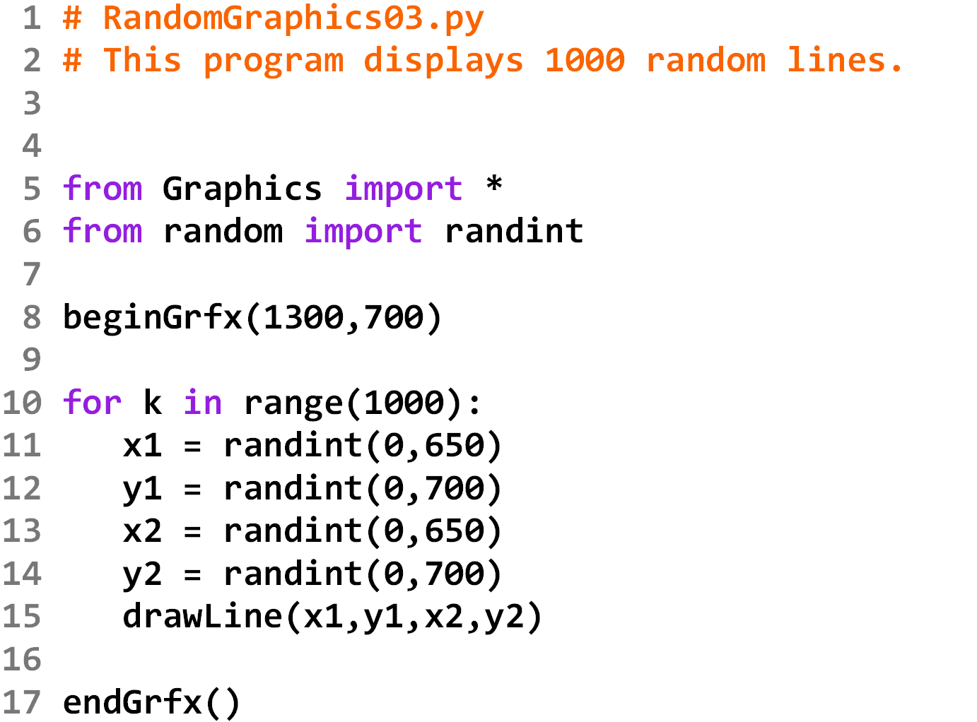
Solution

Slide 33
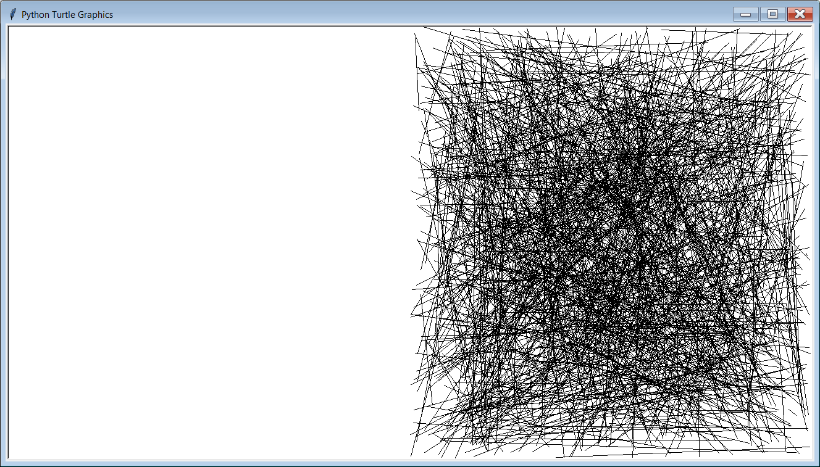
Make the random lines
only show up on the
right ½ of the screen.

Slide 34
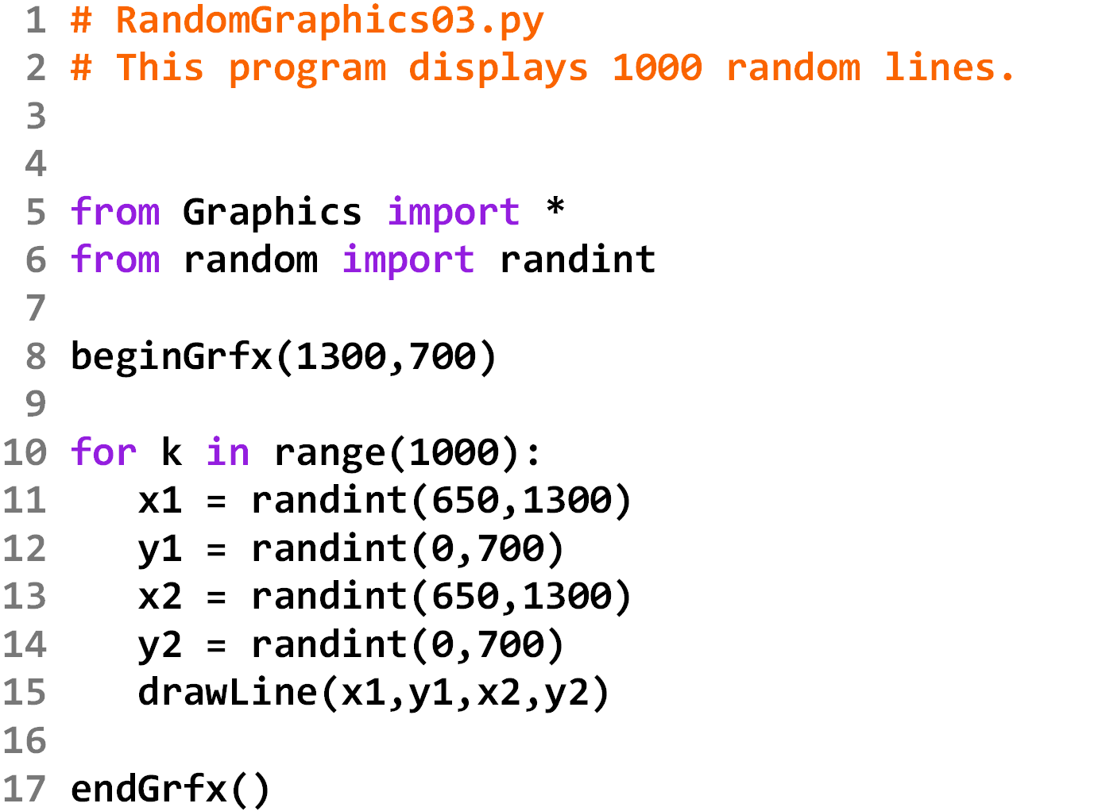
Solution

Slide 35
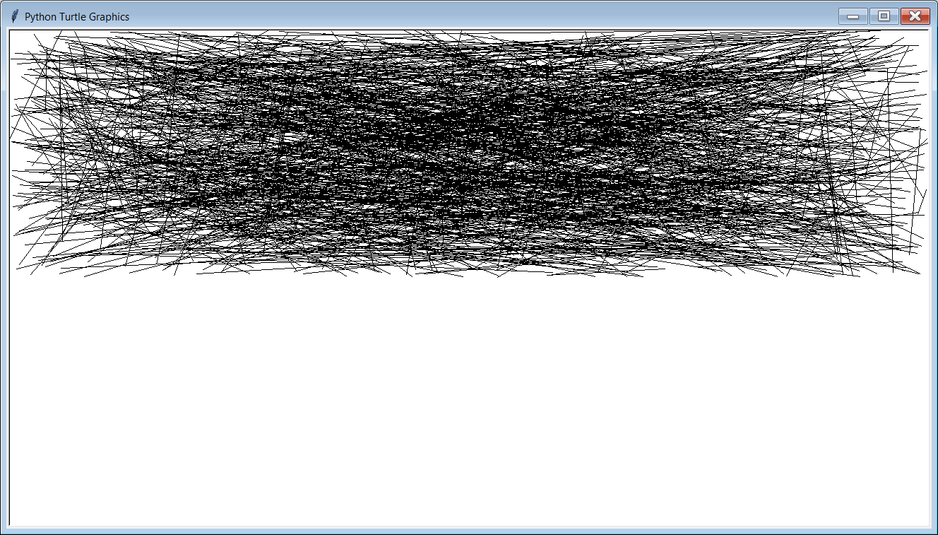
Make the random lines
only show up on the
top ½ of the screen.

Slide 36

Solution

Slide 37
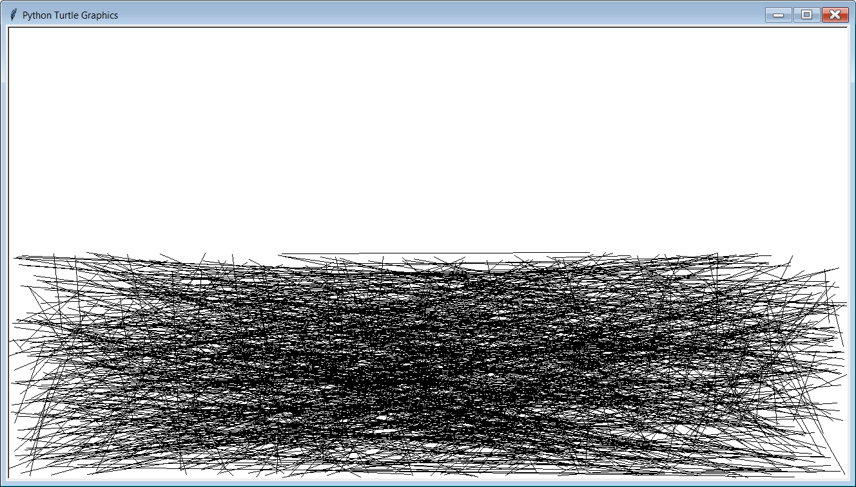
Make the random lines
only show up on the
bottom ½ of the screen.

Slide 38
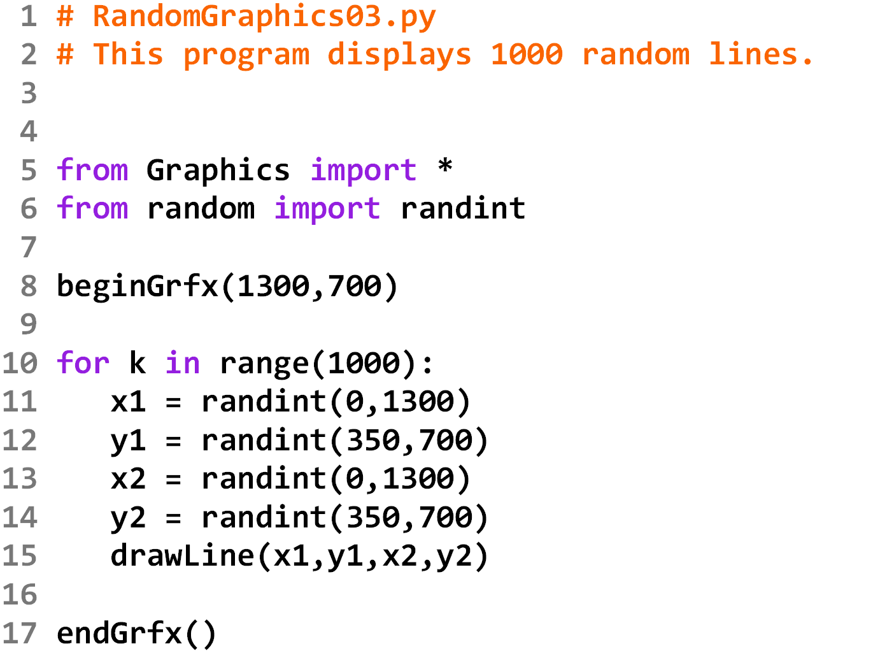
Solution

Slide 39
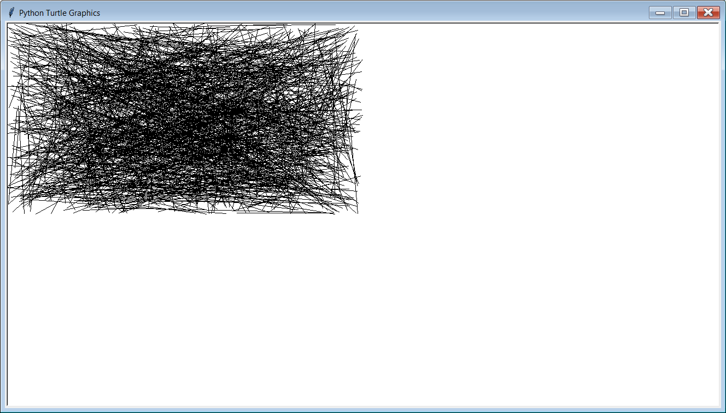
Make the random lines
only show up in the
top-left ¼ of the screen.

Slide 40

Solution

Slide 41
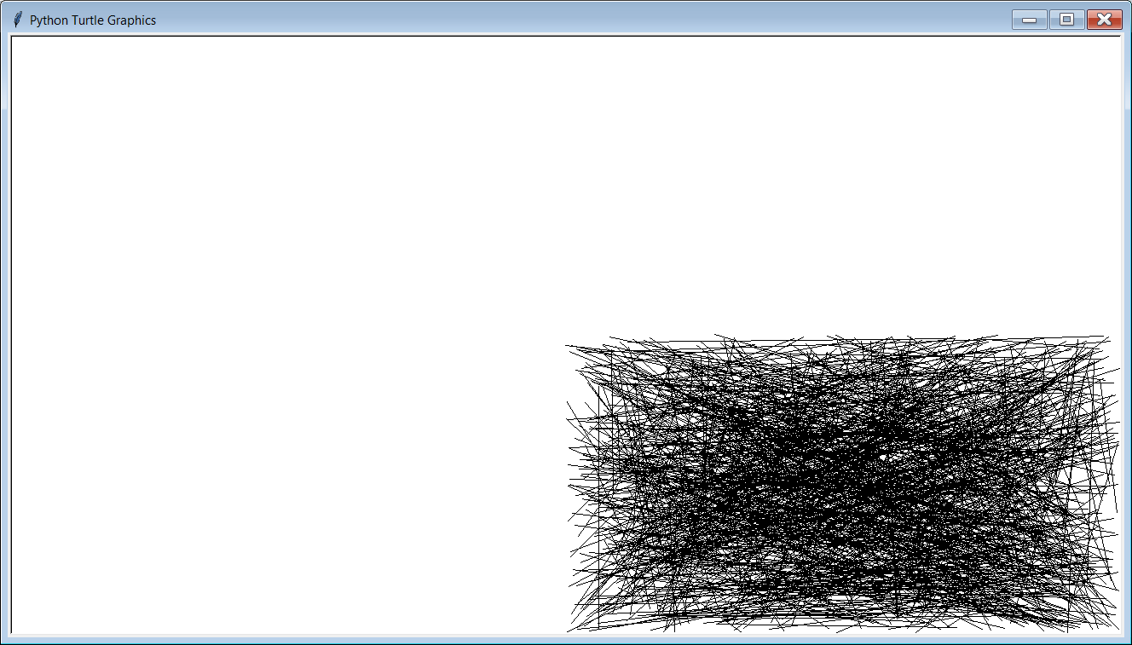
Make the random lines
only show up in the bottom-
right ¼ of the screen.

Slide 42
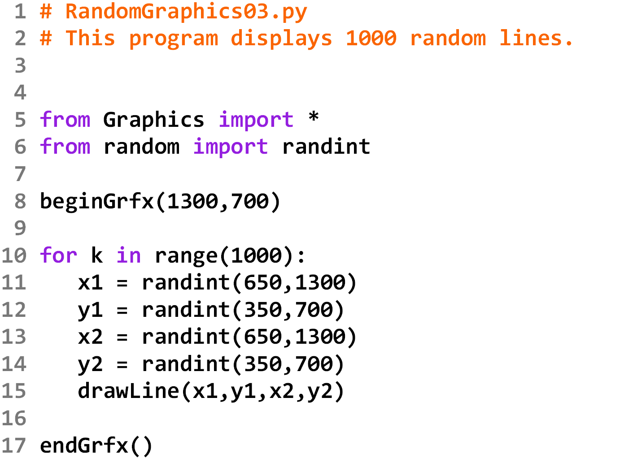
Solution

Slide 43
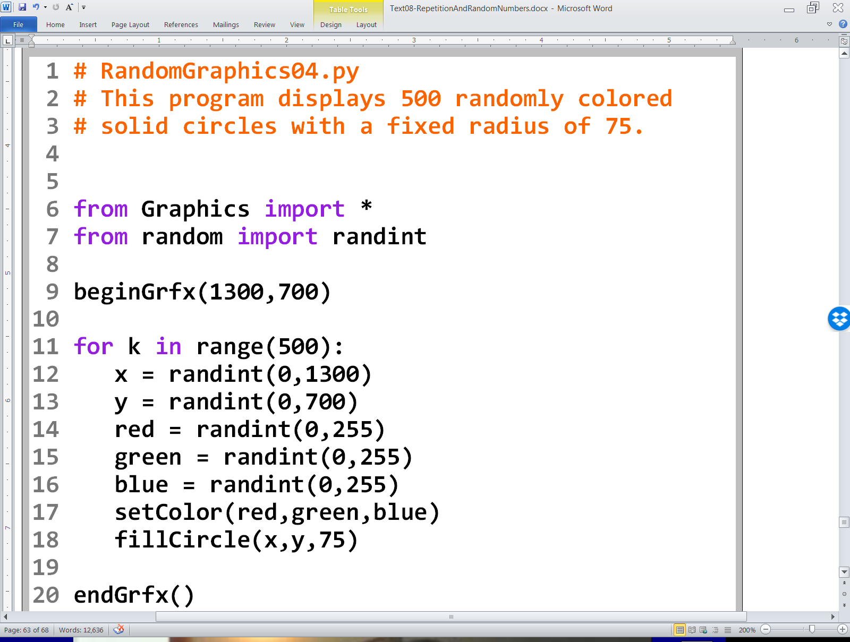

Slide 44
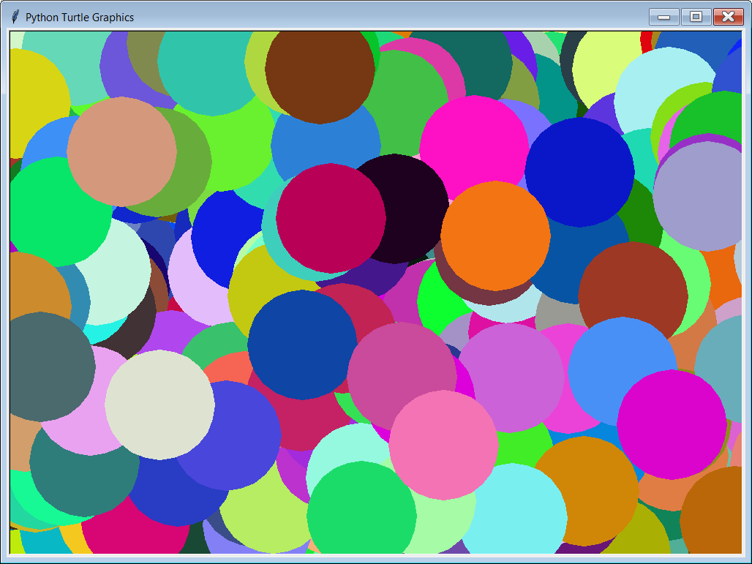

Slide 45
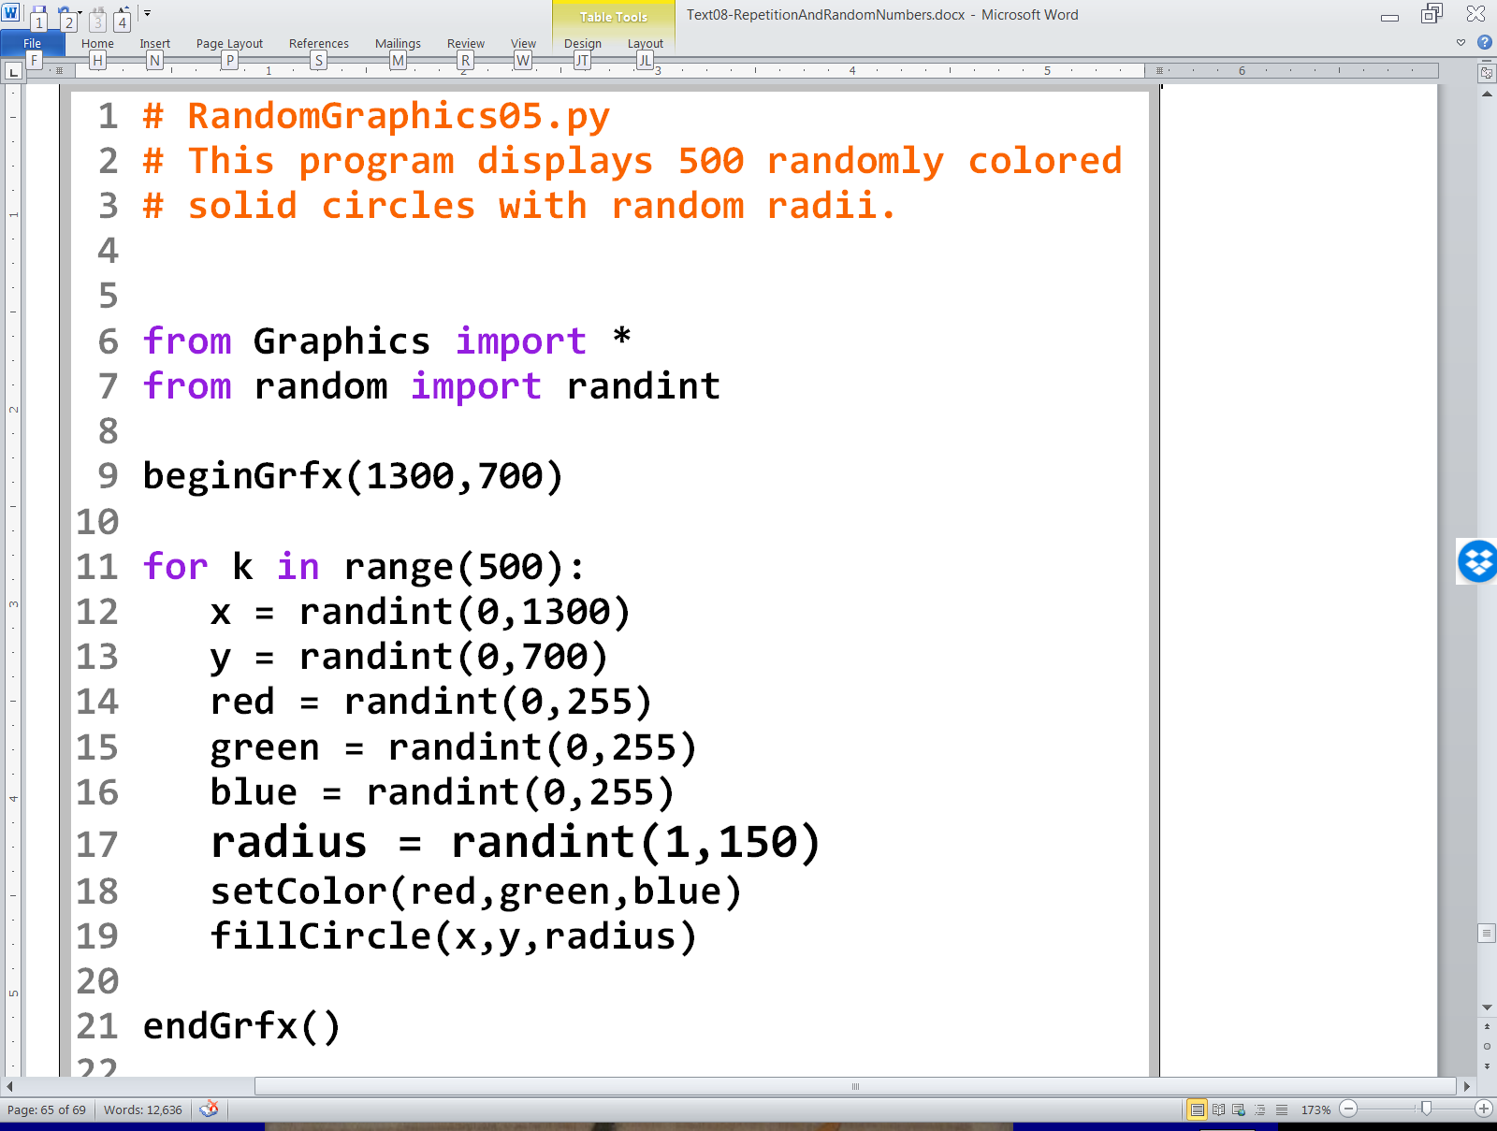

Slide 46
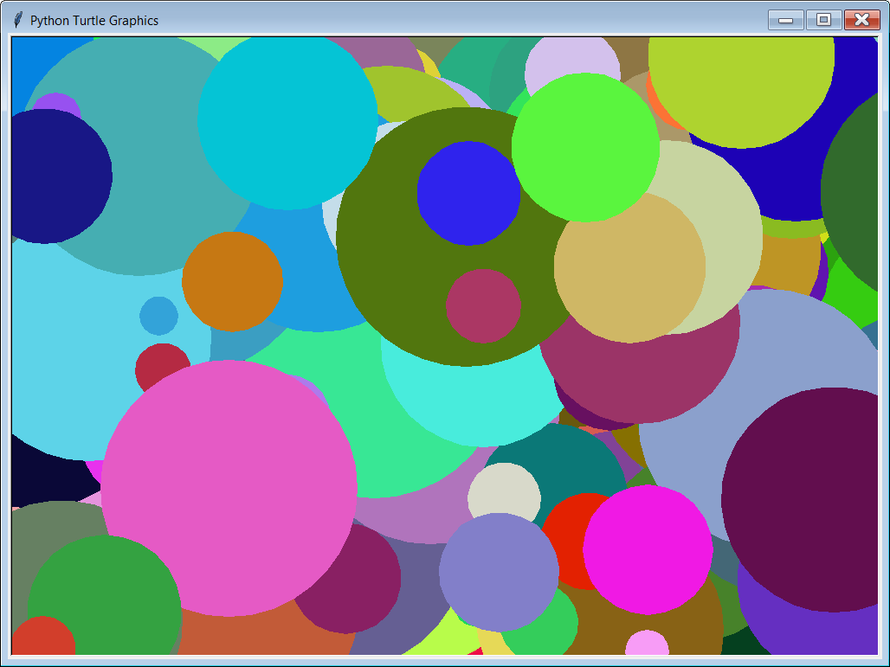

Slide 47
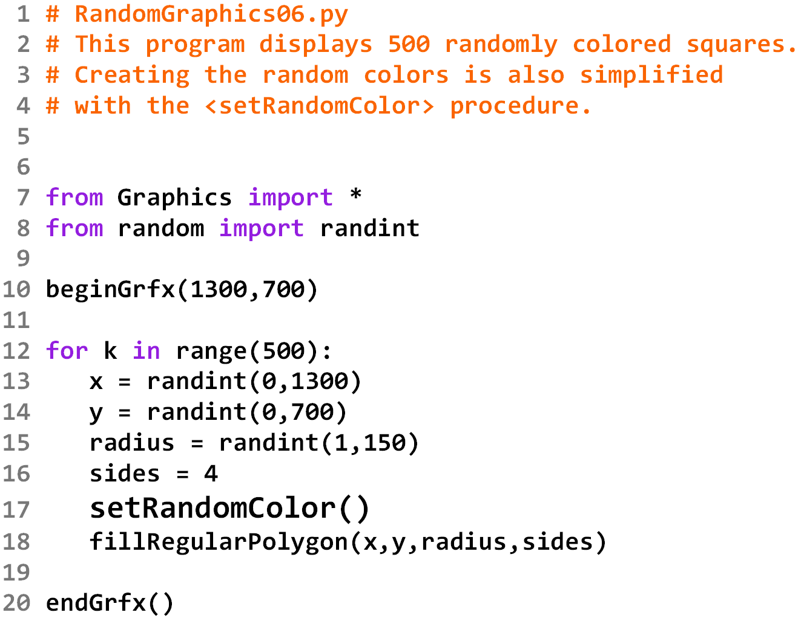

Slide 48
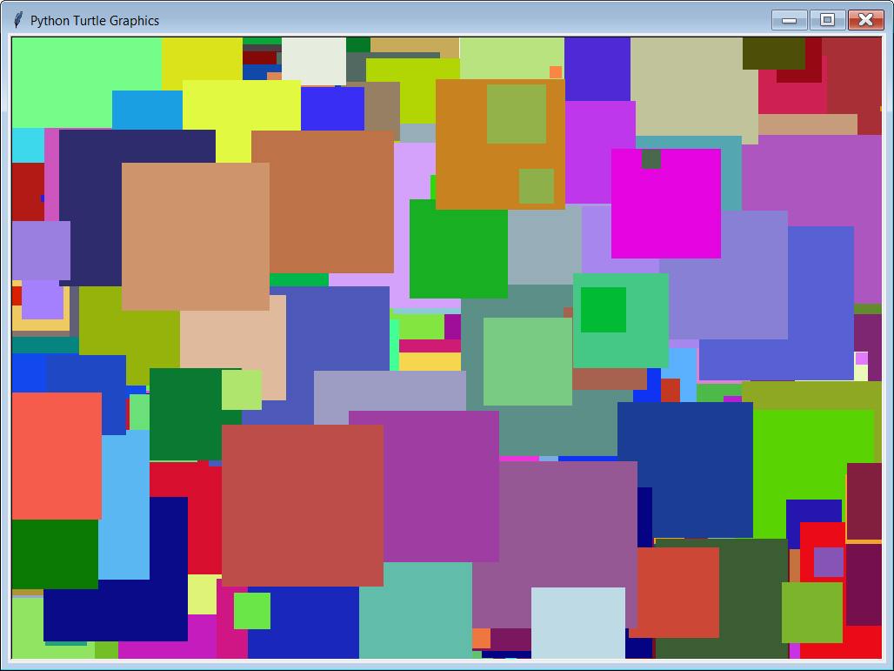

Slide 49
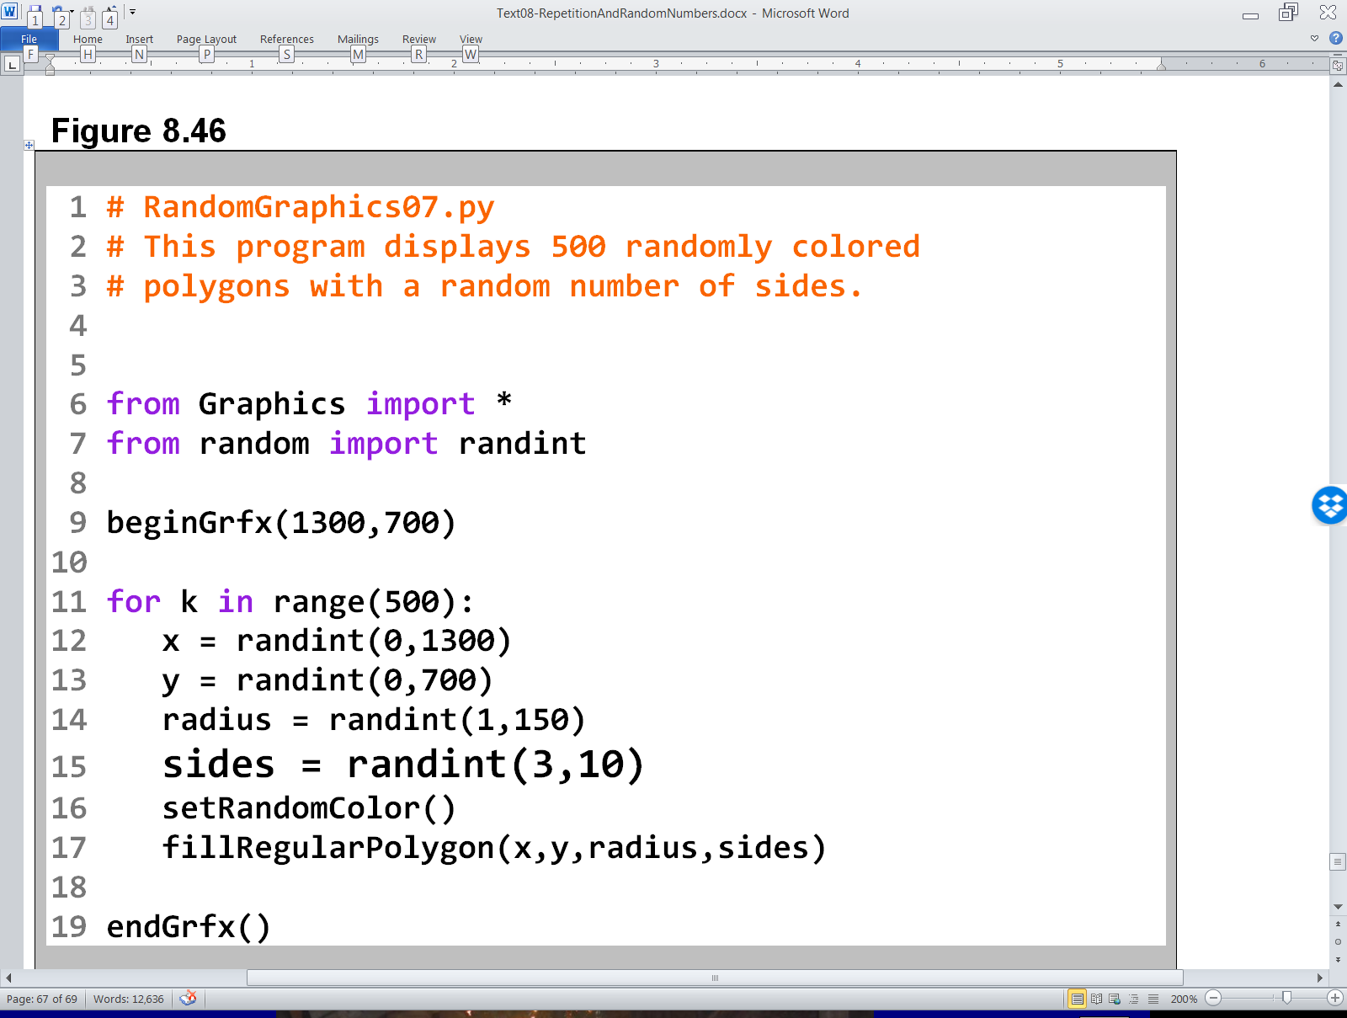

Slide 50
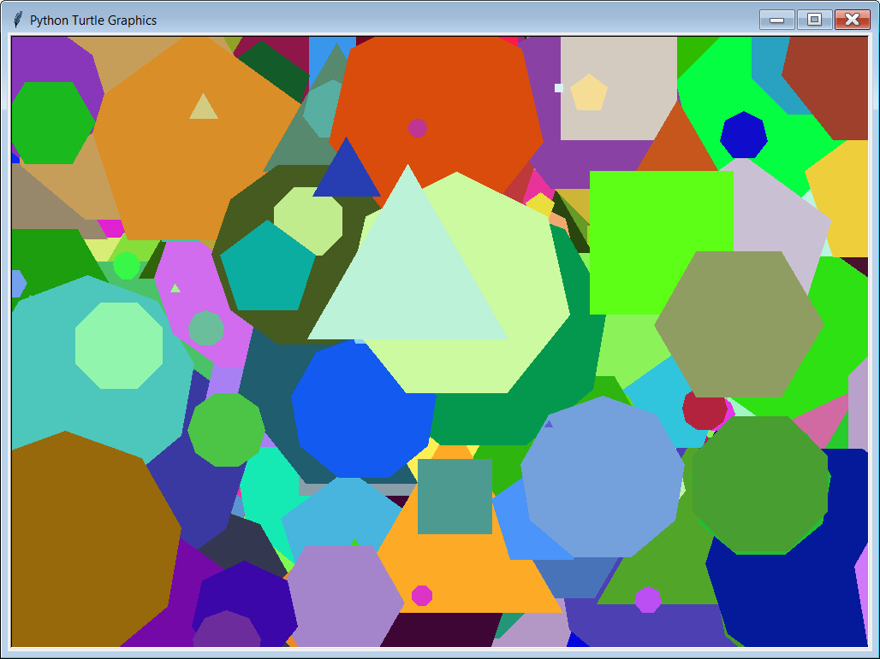

Slide 51
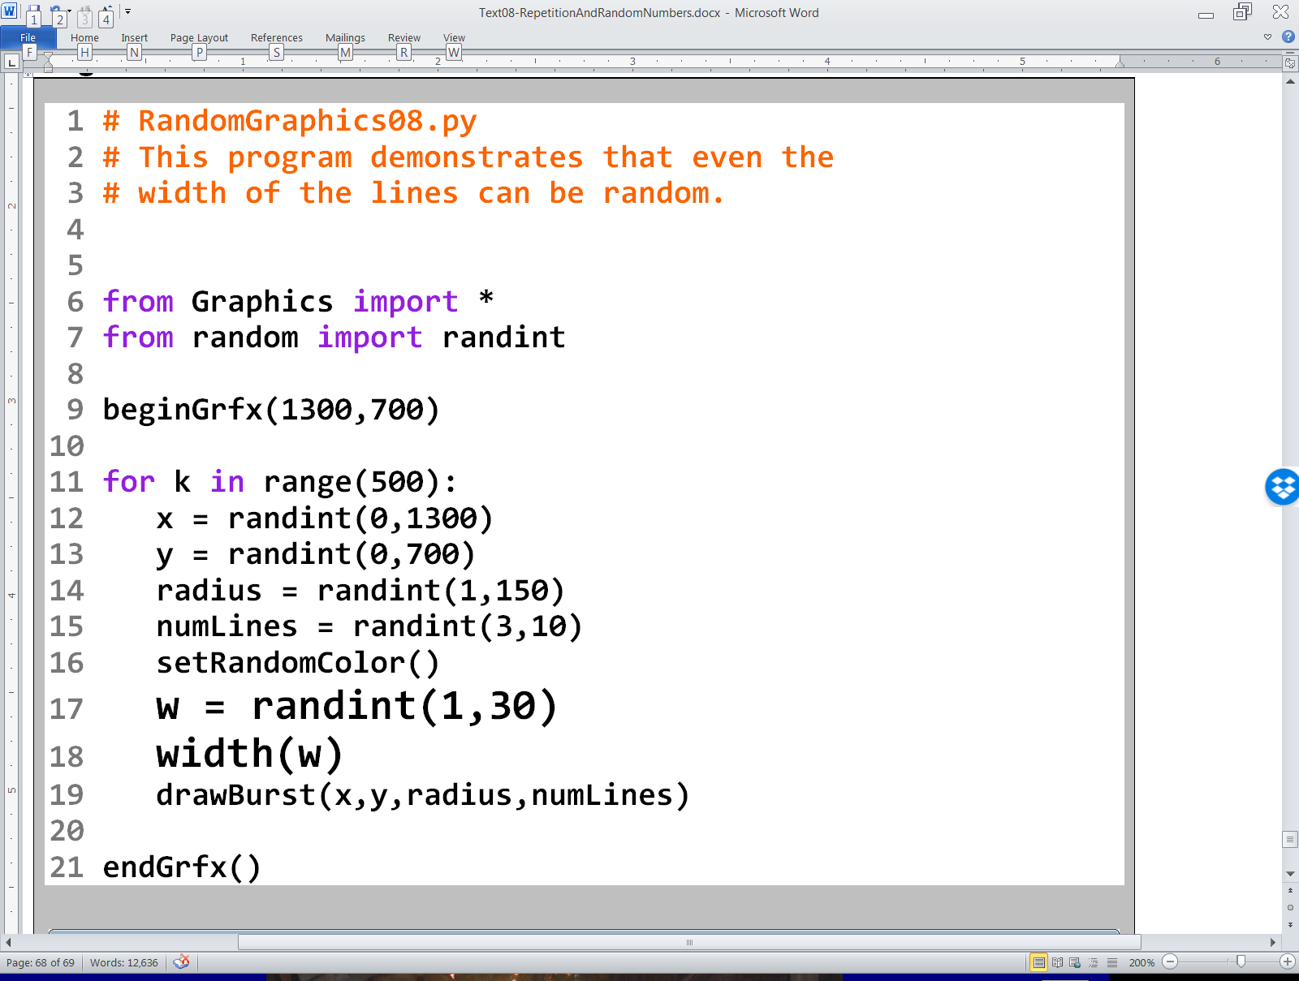

Slide 52


Slide 53

Lab 8C
What you saw in the past 6 program examples relates directly to what
you will be doing in Lab 8C.

